Slide 1
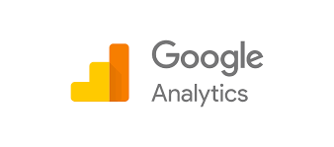

Slide 2
The current Google landscape
Did you know that every day Google processes over 40k search queries every second?
This equals to over 3.5 billion searches per day and 1.2 trillion searches per year worldwide.

Slide 3
Top Traffic Referrers 2016 v. 2017

Slide 4
Google hasn't offered an update in years, but estimates suggest as many as 30–50 million websites use Google Analytics.

Slide 5
According to W3Techs, Google Analytics is being used by 52.9% of all websites on the internet, more than 10 times the next most popular analytics option, Yandex Metrics.

Slide 6
Do you have a blog?
Do you have a website?
If the answer is yes, whether they are for personal or business use, then you need Google Analytics.

Slide 7
How many people visit my website?
Where do my visitors live?
Do I need a mobile-friendly website?
What websites send traffic to my website?
What marketing tactics drive the most traffic to my website?
Sundar Pichai, Google CEO

Slide 8
Which pages on my website are the most popular?
How many visitors have I converted into leads or customers?
Where did my converting visitors come from and go on my website?
What blog content do my visitors like the most?

Slide 9
Set-up your account
First, you need a Google Analytics account.
If you have a primary Google account that you use for other services like Gmail, Google Drive, Google Calendar, Google+, or YouTube, then you should set up your Google Analytics using that Google account.
Or you will need to create a new one.

Slide 10
Don’t let your anyone (your web designer, web developer, web host, SEO person, etc.) create your website's Google Analytics account under their own Google account so they can "manage" it for you.

Slide 11
If you and this person part ways, they may take your Google Analytics data with them, and you will have to start all over and may loose data for a short period.
Some professionals are also know to charge more if traffic rates are increasing, etc.

Slide 12
https://analytics.google.com
Once you have a Google account, you can go to Google Analytics and click the Sign into Google Analytics button.
You will then be greeted with the three steps you must take to set up Google Analytics.

Slide 13
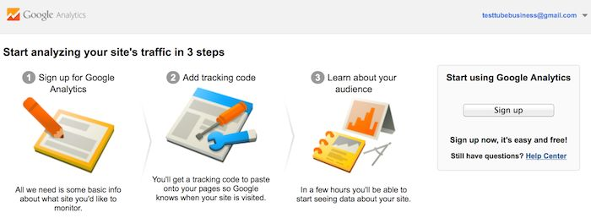

Slide 14
After you click the ‘Sign Up’ button, you will fill out information for your website.

Slide 15
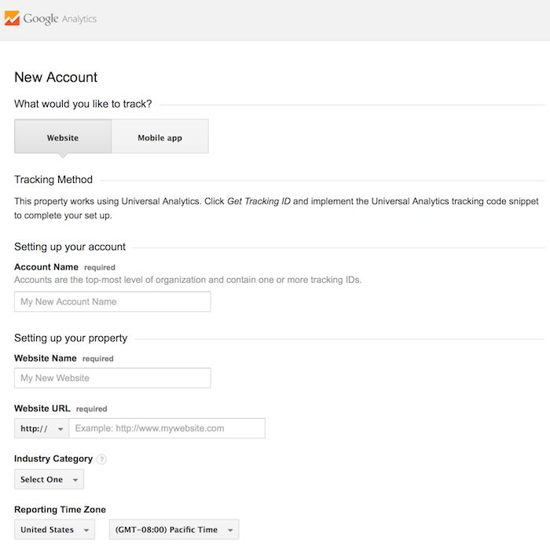

Slide 16
Google Analytics offers hierarchies to organize your account. You can have up to 100 Google Analytics accounts under one Google account.
You can have up to 50 website properties under one Google Analytics account.
You can have up to 25 views under one website.

Slide 17
Suit your needs - big or small!

Slide 18
1: If you have one website, you only need one Google Analytics account with one website property.
2: If you have two websites, such as one for your business and one for your personal use, you might want to create two accounts, naming one ”Business1" and one "Personal". Then you will set up your business website under the ‘Business1’ account and your personal website under your Personal account.

Slide 19
3: If you have several businesses, but less than 50, and each of them has one website, you might want to put them all under a Business account. Then have a Personal account for your personal websites.
4: If you have several businesses and each of them has dozens of websites, for a total of more than 50 websites, you might want to put each business under its own account, such as 123Business account, 124Business account, and so on.

Slide 20
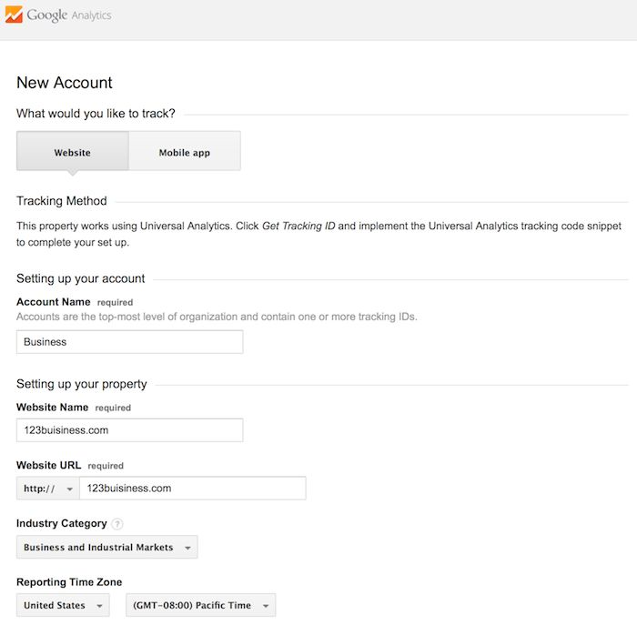

Slide 21
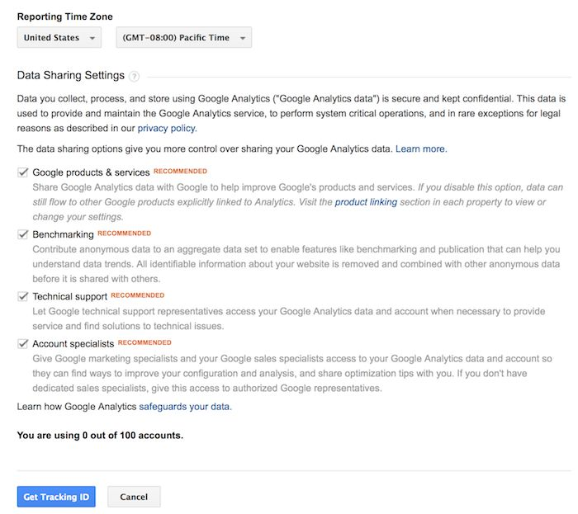

Slide 22
Install your tracking code
Once you are finished, you will click the Get Tracking ID button. You will get a popup of the Google Analytics terms and conditions, which you have to agree to.
Then you will get your Google Analytics code.

Slide 23
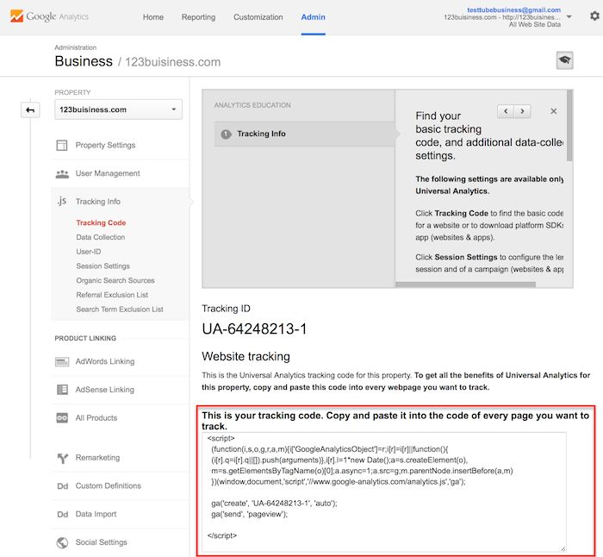

Slide 24
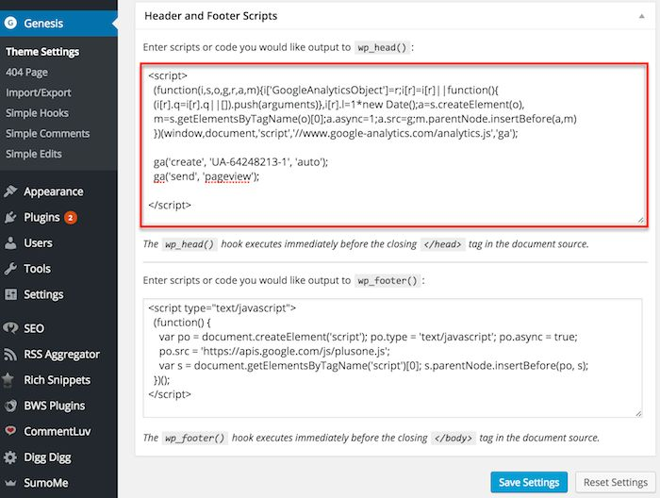

Slide 25
A Google Analytics plugin should accomplish at least two things for you:
It should establish the connection between your site and Google Analytics without you having to update any of your site’s code.
It should add a comprehensive dashboard filled with statistics to your WordPress backend, keeping all the data for your site within WordPress.

Slide 26
The Best Wordpress Plugins to use…
https://wordpress.org/plugins

Slide 27
Google Analytics+ Plugin
https://premium.wpmudev.org/project/google-analytics-for-wordpress-mu-sitewide-and-single-blog-solution/

Slide 28
Google Analytics Dashboard for WP (GADWP)
https://wordpress.org/plugins/google-analytics-dashboard-for-wp/

Slide 29
Analytify Google Analytics Dashboard Plugin (Free)
https://premium.wpmudev.org/blog/google-analytics-plugins/

Slide 30
GA Google Analytics
https://wordpress.org/plugins/ga-google-analytics/

Slide 31
.
To use Google Analytics, you need to upgrade to a Premium Plan and connect your own domain.

Slide 32
Hover over the user panel at the top right and click Domains.
Click the expand arrow next to the domain connected to the site you want to track.
Click the Analytics tab.
Paste your Google Analytics code into the Google Analytics Code field.
Note: Make sure that there are no extra spaces before the code.
Select the IP Anonymization checkbox to ensure that Google does not save your site visitors' IP addresses.
Click Submit.
Tip:
You do not need to add the code to each page of your site (using HTML).
When two or more domains are connected to a site, you only need to add the Google Analytics code to the primary domain.

Slide 34
To add Google Analytics to your site, sign-up for an account and add your site (ex. http://example.weebly.com) to that account.
Google will provide you with a block of code to add to your site. Copy this code - you'll need to paste to a specific area of our editor. If you have trouble finding this code, take a look at Google's help page.
Log in to Weebly and click Edit Site.
Then go to the Settings tab and select the SEO section. Paste the code into either the Header or Footer area. Google prefers the Header currently, but it really doesn't matter that much.

Slide 35
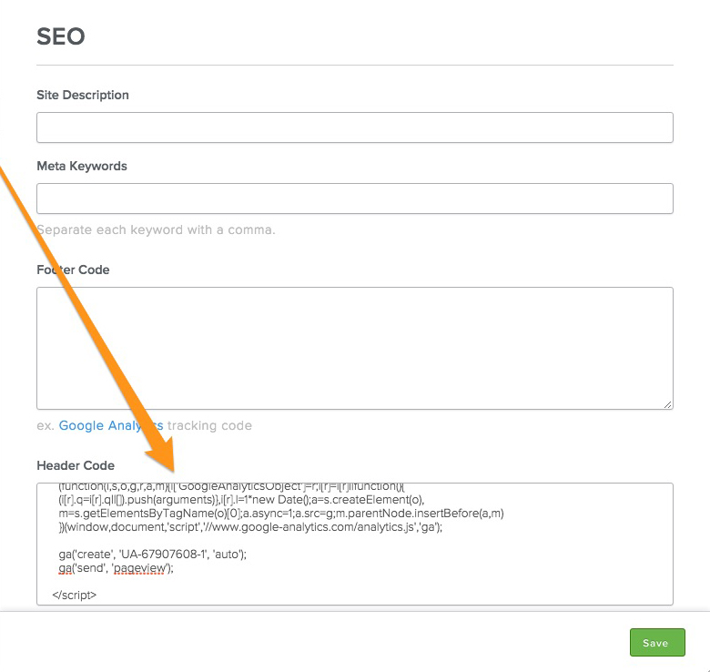

Slide 36
If you have a website built with HTML files, you will add the tracking code before the </head> tag on each of your pages. You can do this by using a text editor program (such as TextEdit for Mac or Notepad for Windows) and then uploading the file to your web host using an FTP program (such as FileZilla).

Slide 37
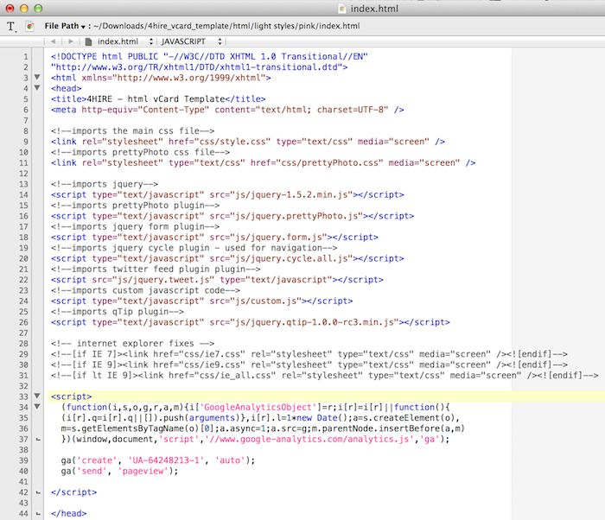

Slide 38
If you have a blog on Tumblr, you will go to your blog, click the Edit Theme button at the top right of your blog, and then enter just the Google Analytics ID in your settings.

Slide 40
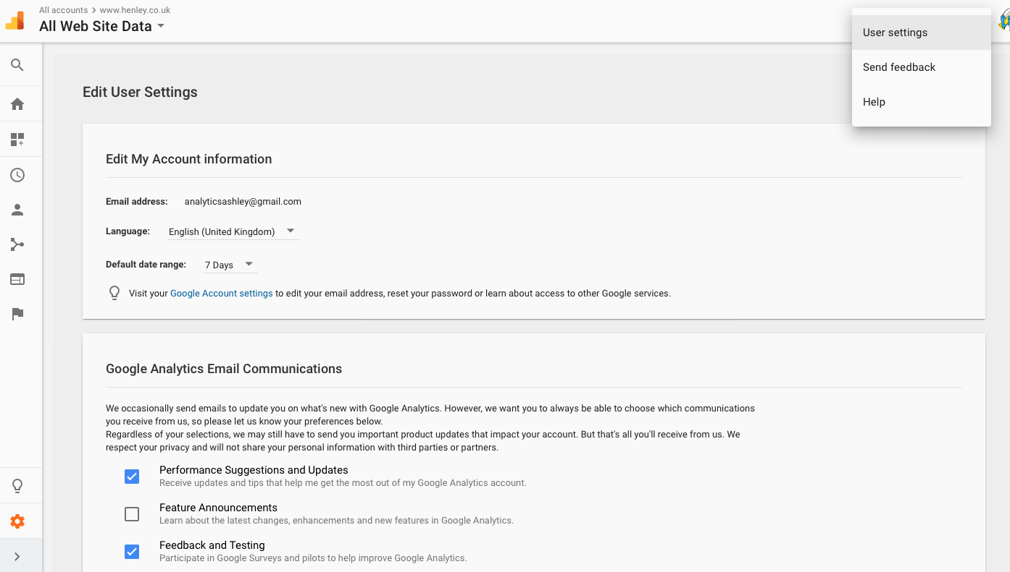

Slide 41
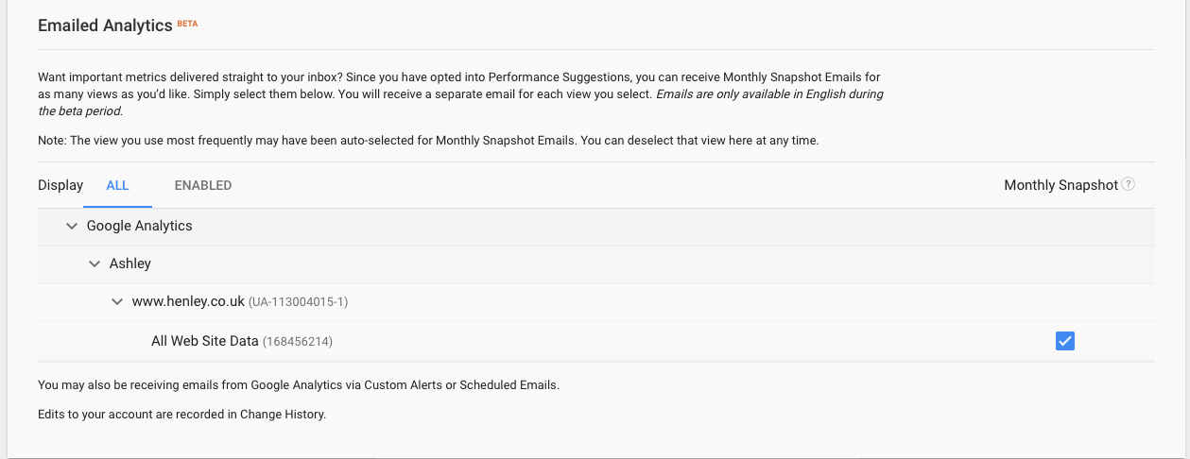

Slide 42
How to view
Google Analytics data

Slide 43
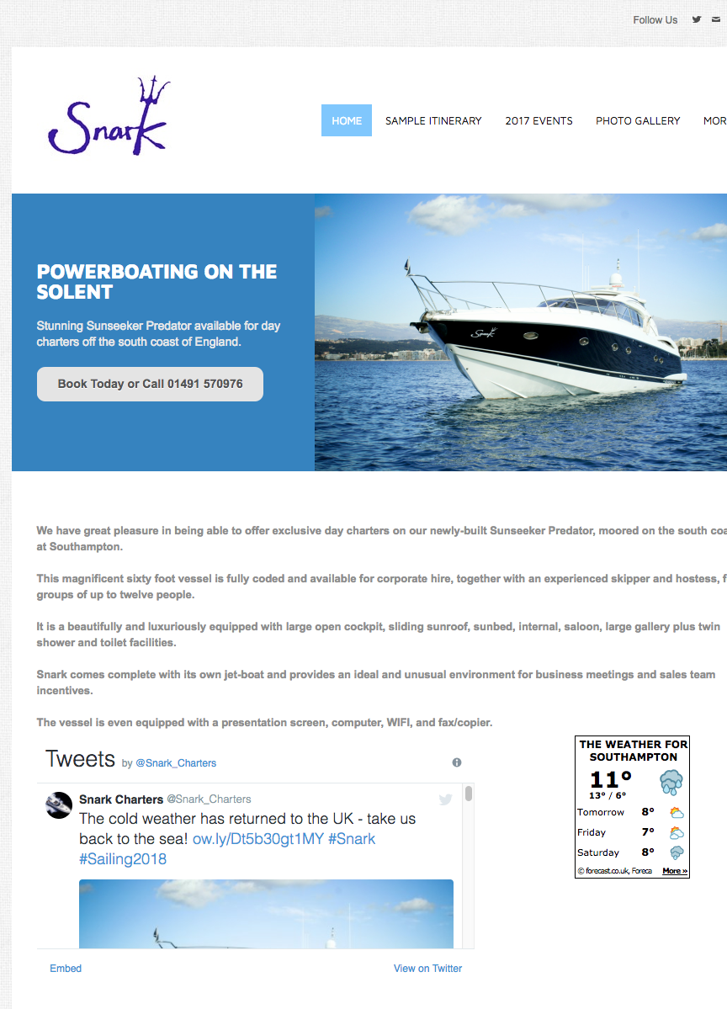

Slide 44
Home is where the heart is…

Slide 45
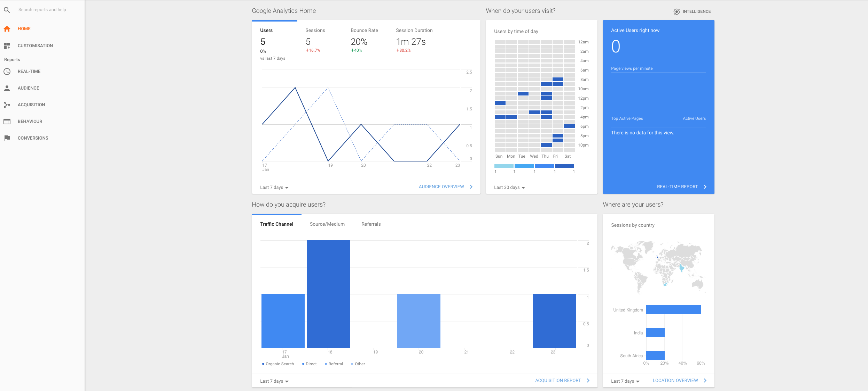

Slide 46
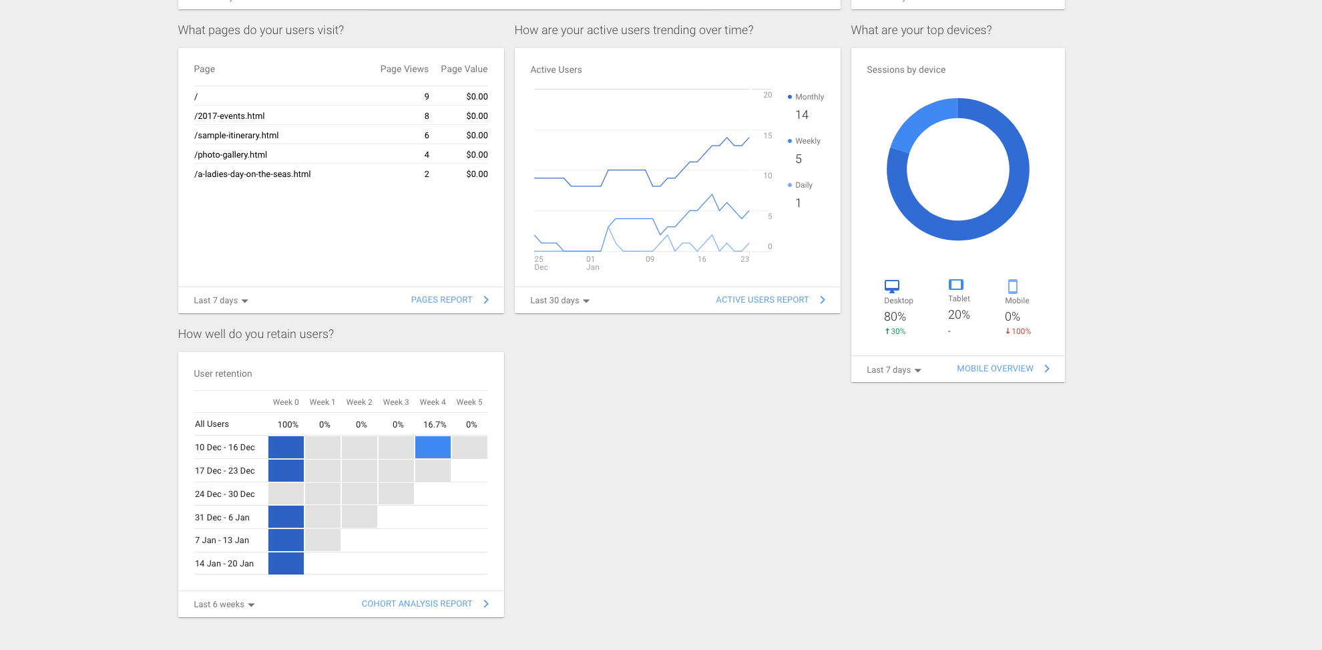

Slide 47
Customisation

Slide 48
Dashboard

Slide 49
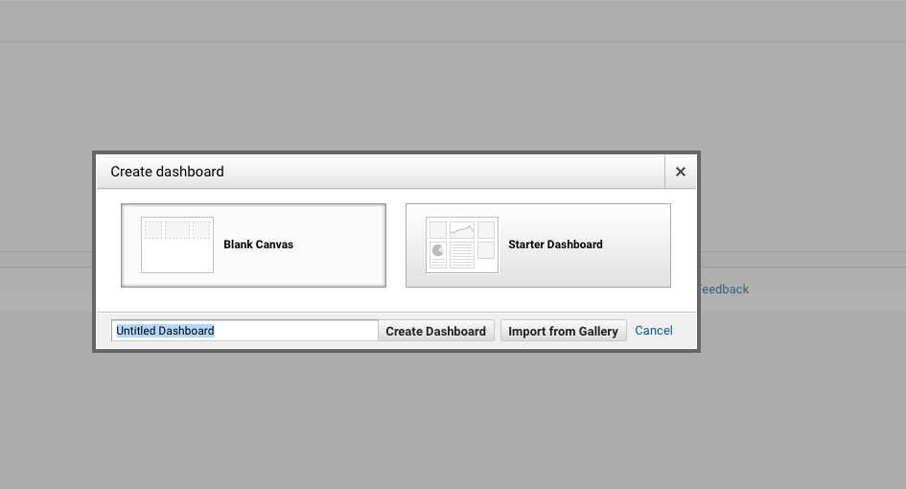
⬆

Slide 50
Real Time

Slide 51
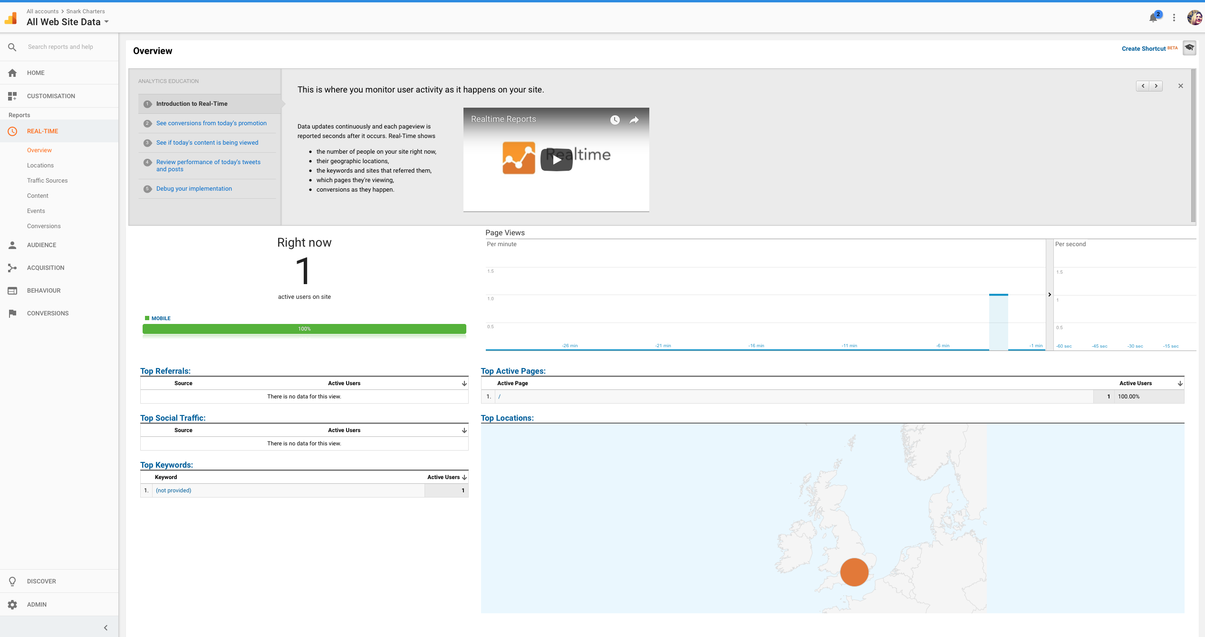

Slide 55
Audience reports
These reports tell you everything you want to know about your visitors. In them, you will find detailed reports for your visitors' age and gender (Demographics), what their general interests are (Interests), where they come from (Geo > Location) and what language they speak (Geo > Language), how often they visit your website (Behavior), and the technology they use to view your website (Technology and Mobile).

Slide 56
Acquisition reports
These reports will tell you everything you want to know about what drove visitors to your website (All Traffic). You will see your traffic broken down by main categories (All Traffic > Channels) and specific sources (All Traffic > Source/Medium).
You can learn everything about traffic from social networks (Social). You can also connect Google Analytics to AdWords to learn more about PPC campaigns and to Google Webmaster Tools / Search Console to learn more about search traffic (Search Engine Optimization)

Slide 57
Behavior reports
These reports will tell you everything you want to know about your content. Particularly, the top pages on your website (Site Content > All Pages), the top entry pages on your website (Site Content > Landing Pages), and the top exit pages on your website (Site Content > Exit Pages).
If you set up Site Search, you will be able to see what terms are searched for (Site Search > Search Terms) and the pages they are searched upon (Site Search > Pages).
You can also learn how fast your website loads (Site Speed) as well as find specific suggestions from Google on how to make your website faster (Site Speed > Speed Suggestions).

Slide 58
Conversions
If you set up Goals within your Google Analytics, you can see how many conversions your website has received (Goals > Overview) and what URLs they happened upon (Goals > Goal URLs). You can also see the path that visitors took to complete the conversion (Goals > Reverse Goal Path).
Speaking of goals and conversions, most of the tables within Google Analytics standard reports will tie specific data to your conversions. For example, you can see the number of conversions made by visitors from California in the Audience > Geo > Location report. You can see the number of conversions made by visitors from Facebook in the Acquisitions > All Traffic > Source/Medium report. You can see the number of conversions made by visitors who landed on specific pages in the Behavior > Site Content > Landing Pages report.

Slide 59
Goals

Slide 60
In Google Analytics, you have four ways to track goals:
URLs
Time
Pages/visit
Events – user interactions with website content that can be tracked independently from a web page or a screen load.
Here’s a complete breakdown on how to set up your goals so you can start tracking the metrics that are critical to the success of your business.

Slide 61
After you install your tracking code on your website, you will want to configure a small (but very useful) setting in your website's profile on Google Analytics. This is your Goals setting.
You can find it by clicking on the Admin link at the top of your Google Analytics and then clicking on Goals under your website's View column.

Slide 62
⬆

Slide 63
Goals will tell Google Analytics when something important has happened on your website.
For example, if you have a website where you generate leads through a contact form, you will want to find (or create) a thank you page that visitors end upon once they have submitted their contact information. Or, if you have a website where you sell products, you will want to find (or create) a final thank you or confirmation page for visitors to land upon once they have completed a purchase.
www.henley.com/thank-you

Slide 64
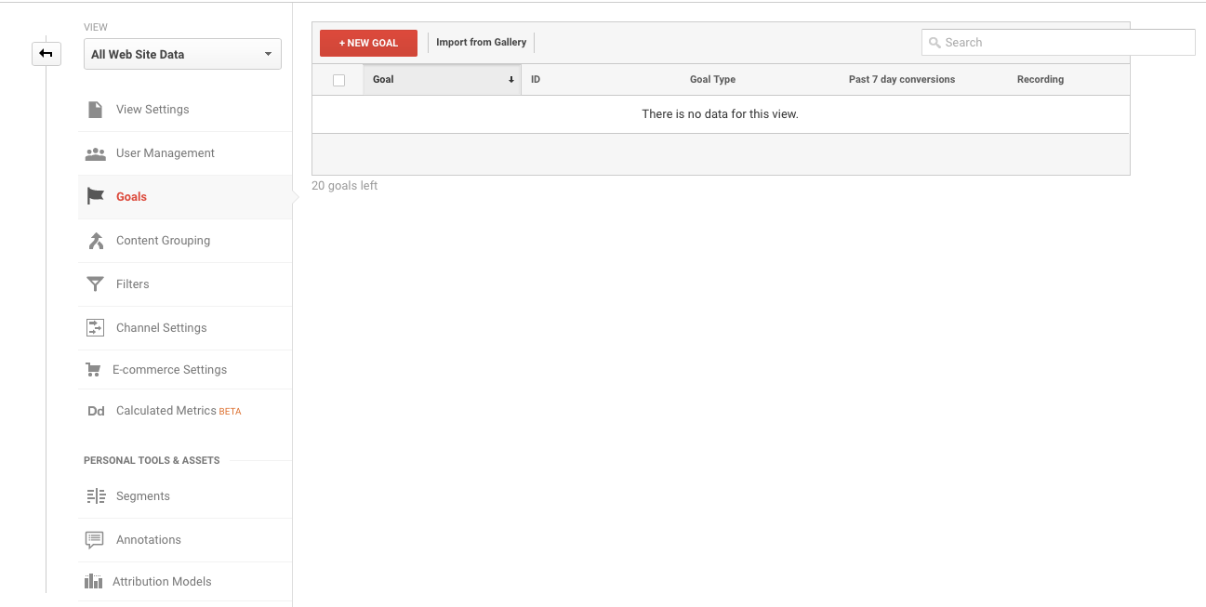
⬆

Slide 65
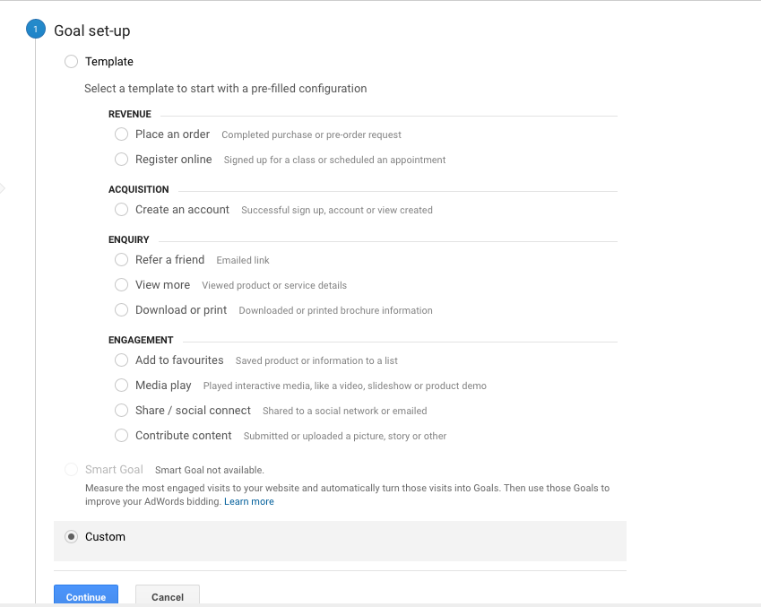
You will choose the Custom option (unless one of the other options are more applicable to your website) and click the Next Step button.

Slide 66
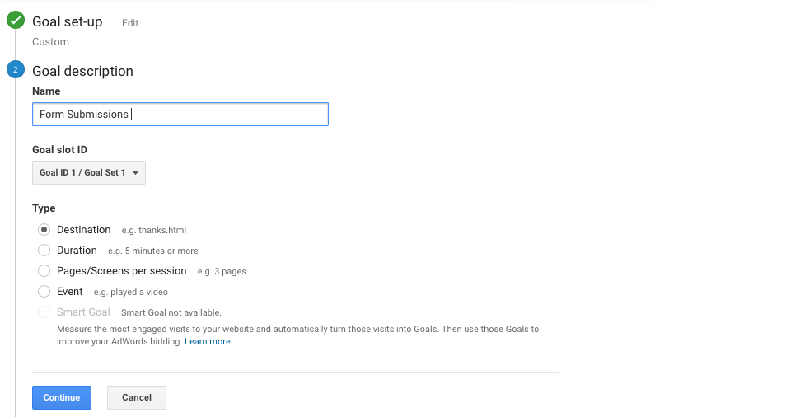

Slide 67
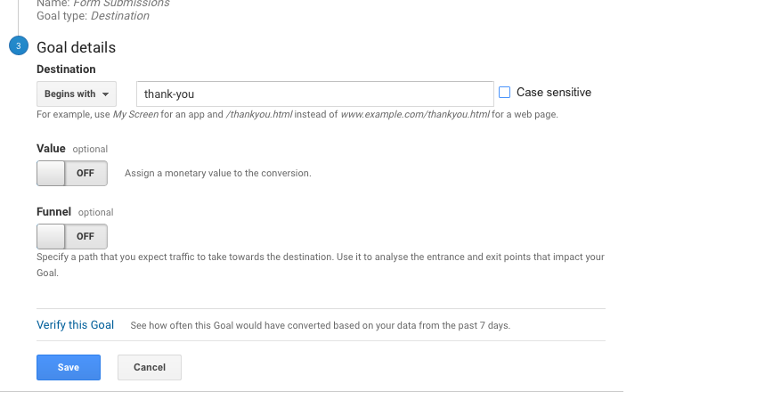

Slide 68
.
If you have other similar goals/conversions you would like to track on your website, you can follow these steps again. You can create up to 20 goals on your website. Be sure that the ones you create are highly important to your business. These goals (for most businesses) include lead form submissions, email list sign ups, and purchase completions. Depending on your website and its purpose, your goals may vary.

Slide 70
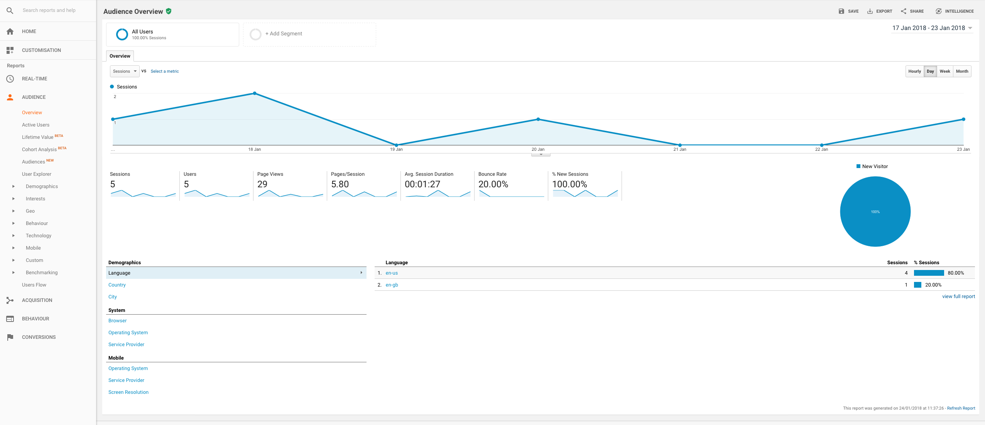

Slide 71
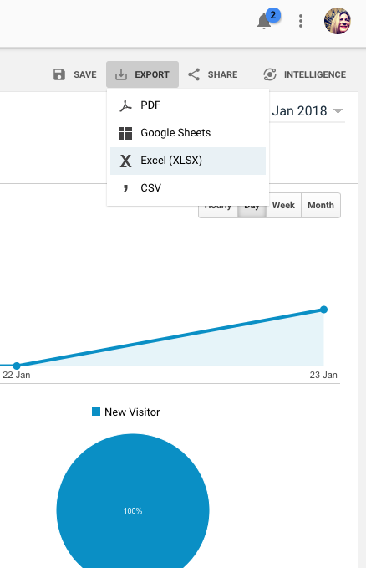
Remember and Export reports if you haven’t set up a monthly email!

Slide 72
How do I share my Google Analytics data with someone?
You don't have to give your Google account information over to someone who needs access to your Google Analytics data. You just need to go to your Admin menu and under the Account, Property (website) or View you want someone to see, click the User Management menu.

Slide 73
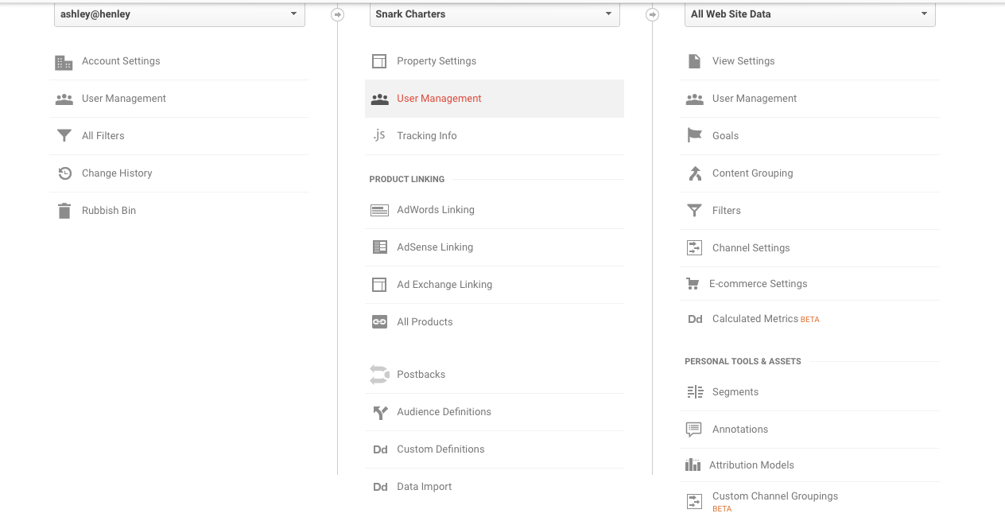

Slide 74
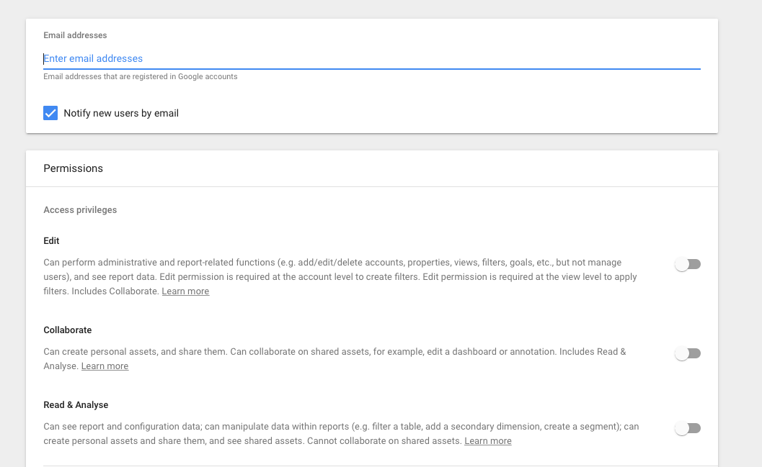

Slide 75
Organic search is based on unpaid, natural rankings determined by search engine algorithms, and can be optimized with various SEO practices.
In contrast, paid search allows you to pay to have your website displayed on the search engine results page when someone types in specific keywords or phrases.

Slide 76
A look at PRACER
PLAN. Create a digital marketing strategy
REACH. Grow your audience online
ACT. Encourage brand interactions and leads
CONVERT. Increase sales through optimisation
ENGAGE. Build customer loyalty and advocacy
RESOURCES. Tools to help you create and implement your plans

Slide 77
How to get more organic traffic
Personal branding.
Successful businesses can generate a ton of momentum from successful entrepreneurs who lead them. Branding yourself, before your company, gives you the opportunity to leverage a more trustworthy, personal image to promote your brand.

Slide 78
How to get more organic traffic
2. Content marketing.
Content marketing takes a variety of forms, and depending on how you form your strategy, could accomplish a number of different goals.
For example, you could use white papers, ebooks and other long-form content to attract downloads, signups and conversions, or you could use an on-site blog to attract more inbound traffic to your site.

Slide 79
How to get more organic traffic
2. Content marketing.
Content marketing takes a variety of forms, and depending on how you form your strategy, could accomplish a number of different goals.
For example, you could use white papers, ebooks and other long-form content to attract downloads, signups and conversions, or you could use an on-site blog to attract more inbound traffic to your site.

Slide 80
How to get more organic traffic
3. Search engine optimization (SEO).
SEO is the process of making your site more visible in search engines, so you get more traffic from people searching for the products or services you offer. Much of your organic search position ranking comes from the technical structure of your site and your ongoing content development strategy.
So, SEO is not much more of an investment if you’re already creating new content regularly -- and it’s well worth that extra investment if for no other reason than to make sure your site is properly indexed.
https://moz.com/google-algorithm-change

Slide 81
How to get more organic traffic
4. Conversion optimization.
Most of these strategies aim to get more people on your site, but what do those people do once they’re there? Conversion optimization helps you ensure you get more value out of each and every visitor by maximizing your rate of conversion.
Sometimes, this means including more conversion opportunities, and other times, improving the ones you already have.

Slide 82
How to get more organic traffic
5. Social media marketing.
Social media marketing isn’t the get-rich-quick scheme you may have been promised, but there is significant potential in building and nurturing a social media audience. Again, content will come into play heavily here, as it will likely be the factor that attracts your audience to begin with. Here, you stand to gain greater brand visibility, a greater reputation and far more inbound traffic with your syndicated links.

Slide 83
How to get more organic traffic
6. Email marketing.
Email marketing has astounding potential for ROI because it costs almost nothing to execute. Start collecting subscribers from your existing customer base, your social media followers and other new opportunities; from there, even a simple content newsletter can help you encourage repeat traffic to your site, facilitate more engagement with your brand and keep your brand top-of-mind with your audience.
Remember you can you a use a Wordpress PlugIn – to get subscribers added to you database: https://en-gb.wordpress.org/plugins/wp-subscribe/

Slide 84
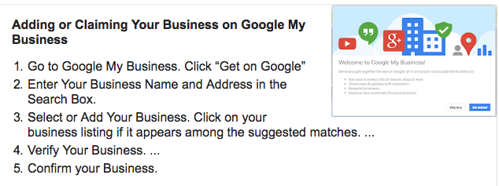
Tip for organic traffic - Is your company on Google (& Maps)?
https://www.google.com/business/

Slide 85
Questions?
Ashley Mackie – ashley@ashleymackie.com
www.talentedmarketing.com for downloads
If you struggle with the elements – I would be happy to set up Google Analytics for you/help with the Dashboard.

