Slide 1
Websites and Blogs
Ashley Mackie
Downloads available: www.talentedmarketing.com
ashley@ashleymackie.com

Slide 2
Introductions

Slide 3
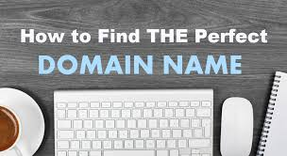
Choosing a domain name is similar to choosing a company name — it requires a lot of thought and consideration. Your domain name is your identity on the web; you want to make sure you choose a domain name that not only fits your business, but is also easy to find and promote.

Slide 4
1. Make it easy to type
Finding a domain name that’s easy to type is critical to online success.
If you use slang (u instead of you) or words with multiple spellings (express vs. xpress), it might be harder for customers to find your site.

Slide 5
2. Keep it short
If your domain name is long and complex, you risk customers mistyping or misspelling it.
Short and simple is the way to go.
Perhaps think about hashtags…

Slide 6
3. Use keywords
Try using keywords that describe your business and the services you offer.
For example, if you’re a windscreen glass replacement business, you may want to register WindscreenGlassRepair.com or CarGlassReplacement.com.

Slide 7
Remember!
Having your name as a domain is a good thing, however, you will need to work on the SEO side to build awareness and traffic.
For example – I own AshleyMackie.com – however, I needed to purchase talentedmarketing.com as I felt the traffic rate was very low.
Talentedmarketing.com now ranks number one out of 36,200,000 results

Slide 8
4. Target your area
4. Target your area
If your business is local, consider including your city or state in your domain name to make it easy for local customers to find and remember.
Example: HenleyAutoGlassRepair.com.

Slide 9
5. Avoid numbers and hyphens
Numbers and hyphens are often misunderstood — people who hear your website address don’t know if you’re using a numeral (5) or it’s spelled out (five) or they misplace or forget the dash. If you need these in your domain, register the different variations to be safe.

Slide 10
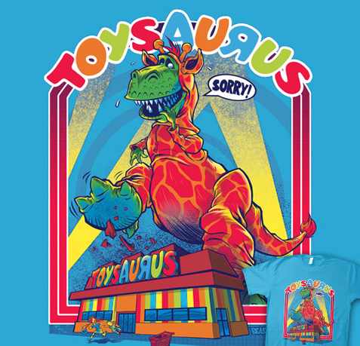
6. Research it
Make sure the name you’ve selected isn’t trademarked, copyrighted or being used by another company.
The toysaurus.com example:

Slide 11
7. Use an appropriate domain name extension
.com (commercial) – This is the most popular extension and originally stood for commercial sites, but now it is used for all kinds of websites.
.co.uk (United Kingdom) – The last part of the internet address belongs to a UK based company.
.net (network) – Originally intended for networked websites, this domain extension is used for a wide variety of purposes today. This is a good backup if your ideal choice is taken in the .com extension. It’s also good for tech companies as “net” implies technology and networking.

Slide 12
.org (organization) – meant for organizations. Best used if your website is for a nonprofit company. Not the ideal solution if you’re a business as it sends mixed messages.
.edu (education) – This one isn’t typically available for public registration, and is instead used by colleges and educational institutions.

Slide 13
.info (information) – This is best used if your website is purely there for information or as a database of knowledge. If you’re not selling anything, then this domain could work well.
.biz (business) – An alternative to .com domains for businesses, but it does have some bad connotations because of spammy sites using it.
.me (personal) – This extension is often used for personal websites or blogs that have no commercial intent.

Slide 14
Remember…Today there are 19 million registered domain names
You may need to compromise!

Slide 15
Google keyword research
- See separate document – end of slide deck.

Slide 16
Blogging
From the very first blog created in 1994 to today’s microblogging platforms, blogging is at the center of the evolution of the internet.
Exhibit A - Carrie Bradshaw – NYC columnist in 1998 = the blogger of 2018

Slide 17
Best blogging platforms to use
In 2017, there are a number of different ways to start and manage a blog online. Where early bloggers often used LiveJournal, TypePad, and Blogger, the field has widened considerably with the addition of services like Tumblr, WordPress, Medium, and Squarespace, which help creators build and maintain sites.

Slide 18
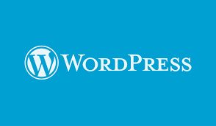
Tumblr, Squarespace, and WordPress aren’t just used for blogging. In fact, in February 2014, it was estimated that 74.6 million websites ran on WordPress, and 18.9% of all self-hosted websites on the internet were WordPress sites.
As of December 2016, 75 million websites run on WordPress.

Slide 19
If you decide to go with WordPress, you will definitely be with good company. The New York Times, CNN, Mashable, and eBay all run their blogs on the most popular CMS in the world – WordPress.

Slide 20
If you decide to go with WordPress, you will definitely be with good company. The New York Times, CNN, Mashable, and eBay all run their blogs on the most popular CMS in the world – WordPress.

Slide 21
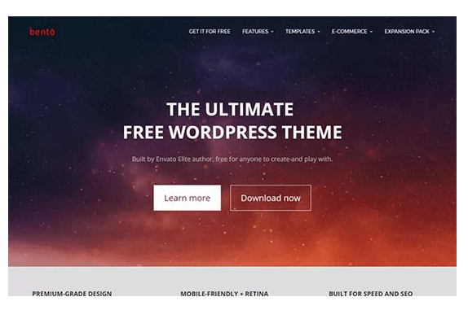
http://www.wpbeginner.com/showcase/best-free-wordpress-blog-themes/

Slide 22
Blog flow
Step 1: Plan your blog post by choosing a topic, creating an outline, conducting research, and checking facts.
Step 2: Craft a headline that is both informative and will capture readers’ attentions.
Step 3: Write your post, either writing a draft in a single session or gradually word on parts of it.
Step 4: Use images to enhance your post, improve its flow, add humor, and explain complex topics.
Step 5: Edit your blog post. Make sure to avoid repetition, read your post aloud to check its flow, have someone else read it and provide feedback, keep sentences and paragraphs short, don’t be a perfectionist, don’t be afraid to cut out text or adapt your writing last minute.

Slide 23
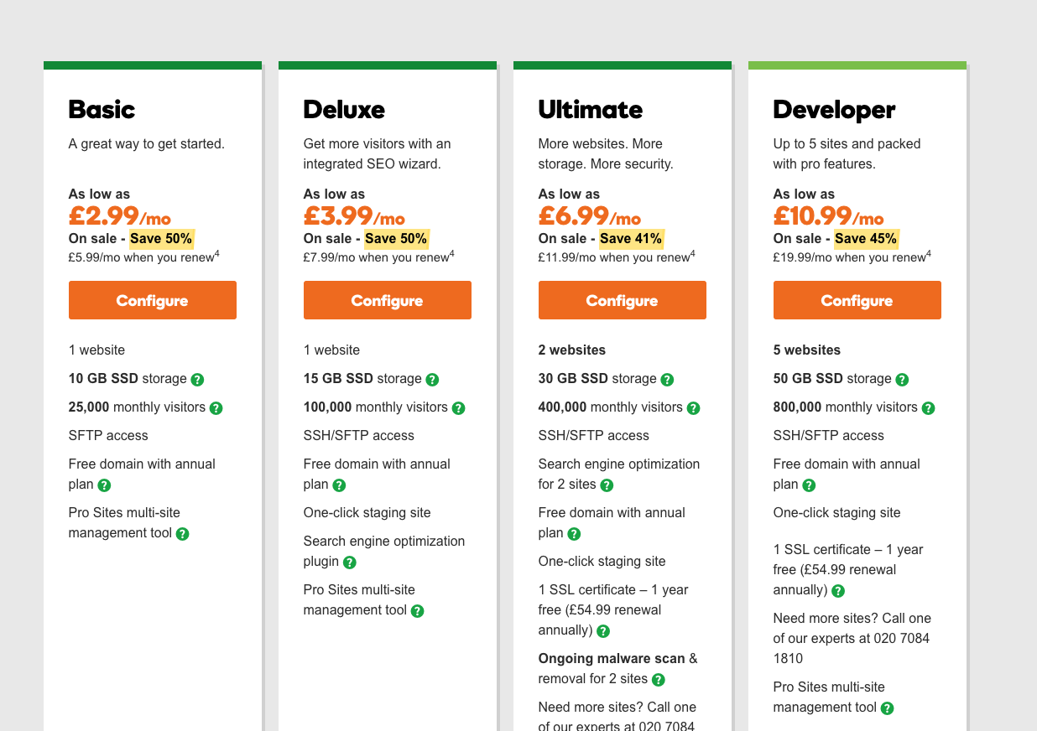
Costs

Slide 24
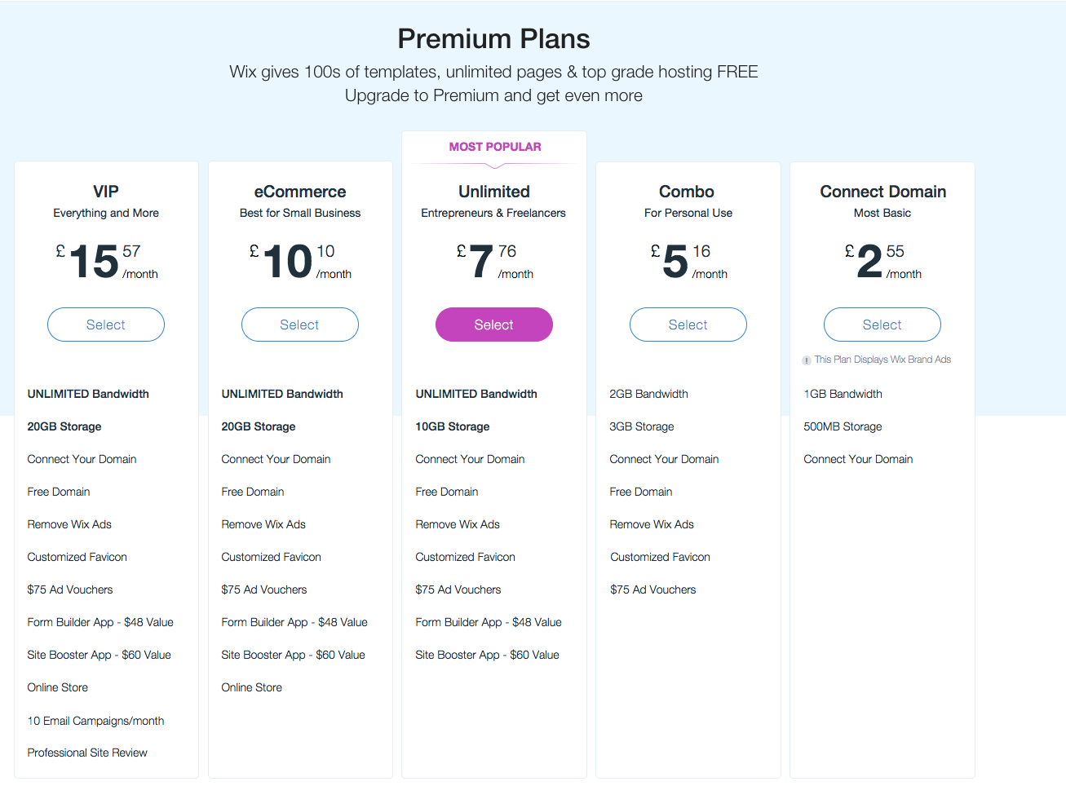
Costs

Slide 25
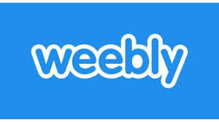
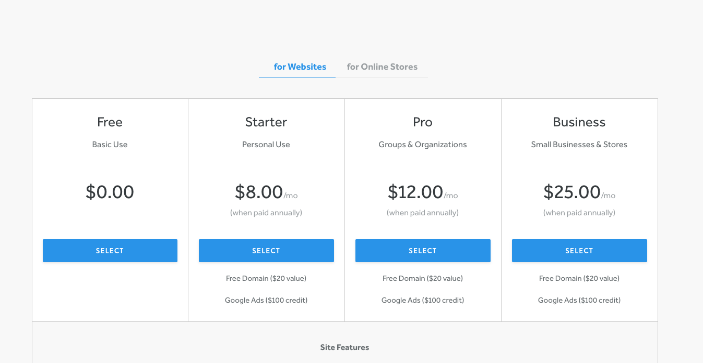
Costs

Slide 26
What to talk about…

Slide 27
- Google keyword research https://adwords.google.com https://trends.google.com/trends/

Slide 28
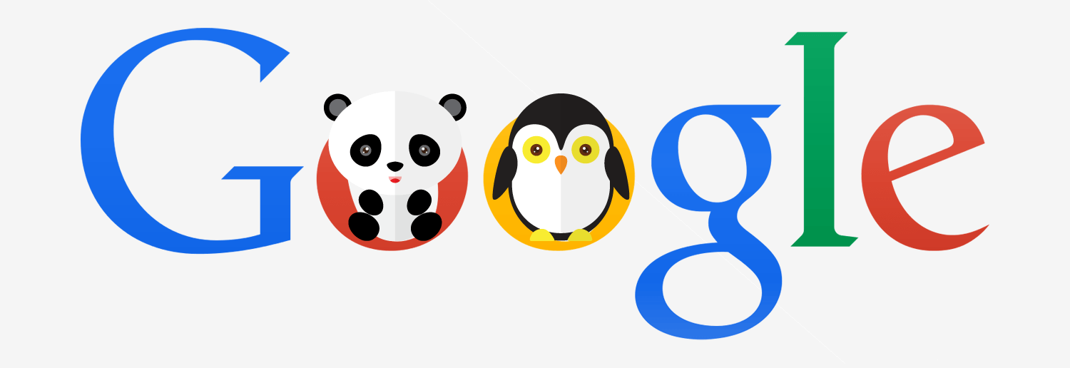
Quality Content – Google Algorithms
https://moz.com/google-algorithm-change

Slide 29
Length?
If you write a really long blog post (1000 words or more), you have a higher chance of ranking well in Google.
A blog should contain at least 300 words
Google just has more clues to determine what your text is about. If you optimize your copy well, your keyword will be in the text rather often, because it’s so lengthy.
If you feel you have over 2,500 words then start a blog series

Slide 30
Do you need a website or a blog?
Blog is easier to maintain and may have everything you need
If ecommerce is the direction you want to go, then I would suggest a website: Home Page
About You
Retail Section
Contact Us
News Page (for blogging, etc)

Slide 31
What are my goals for the site?
Traffic that will lead to conversions
Awareness of you/your brand
Portfolio
Online CV
Galleries
Forum

Slide 32
What am I trying to sell or promote?
What are the components to getting a website up and running?
What content do I need to build the site?
Do I hire a professional or do it myself?
What are my responsibilities to create an effective site?

Slide 33
Typically an agency will charge:
£35 – £250 per hour for web work
£30 – £1,500 Web page creation/testing, etc
Hosting costs - £30-£100 per month
Ongoing costs include hosting fees that can range from £30 – £100 per month.

Slide 34
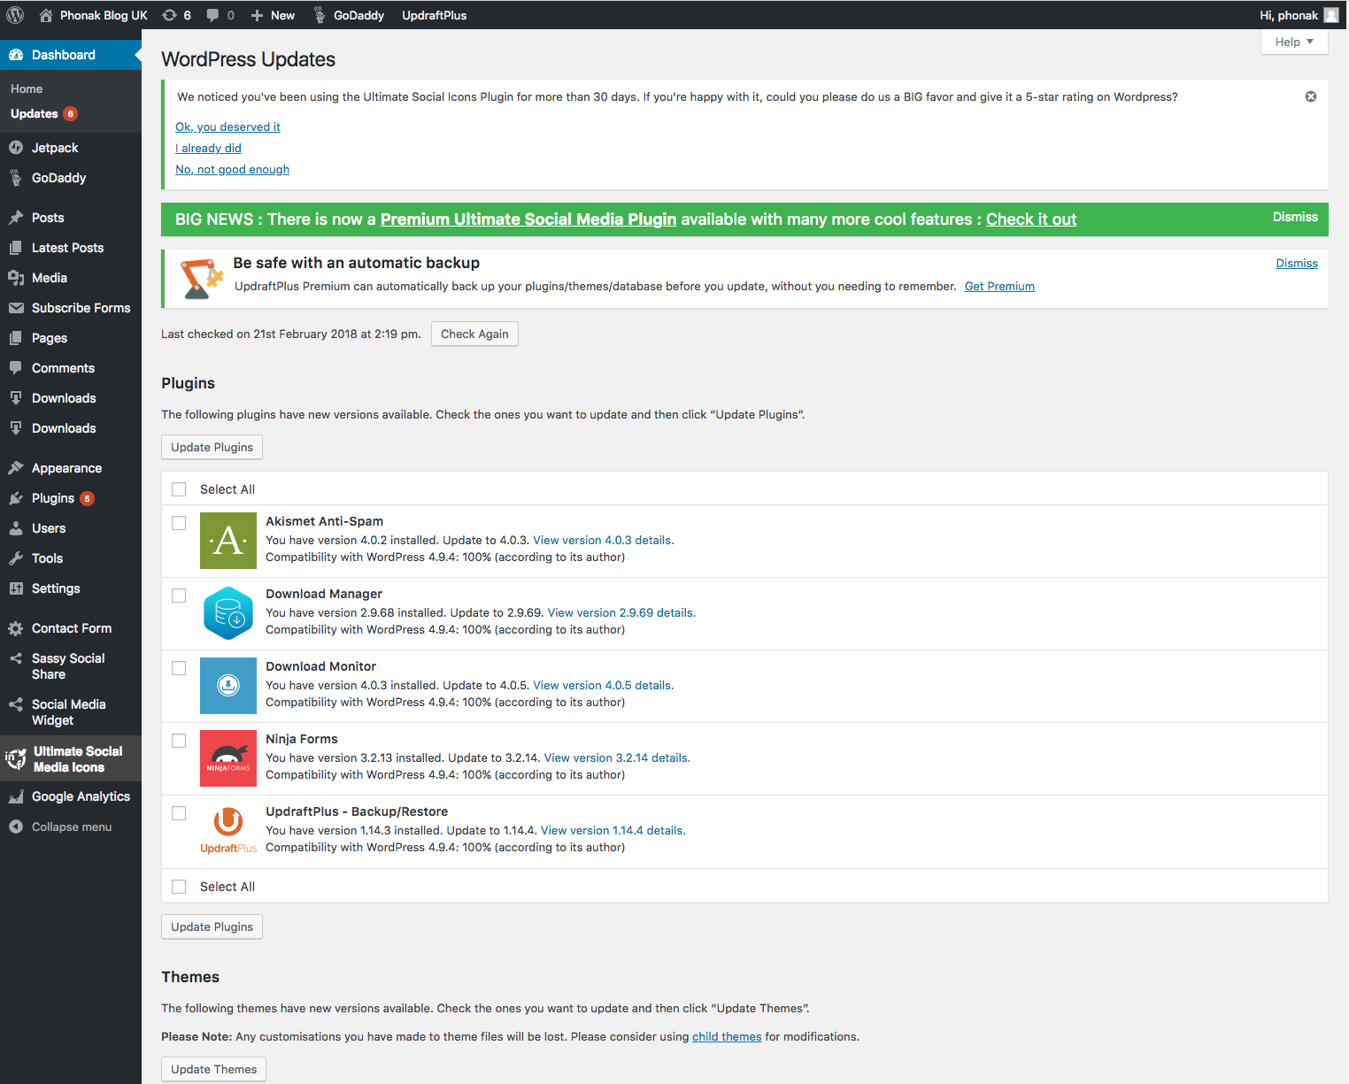

Slide 35
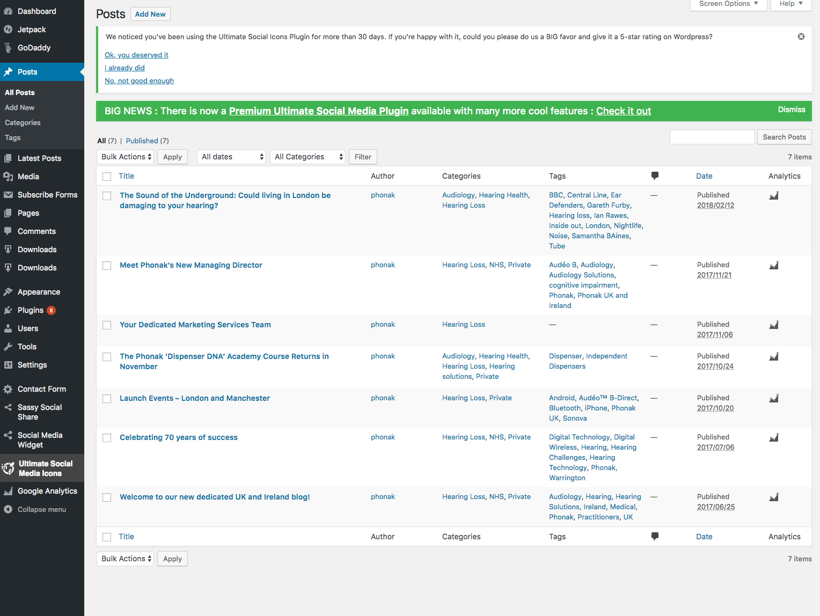

Slide 36
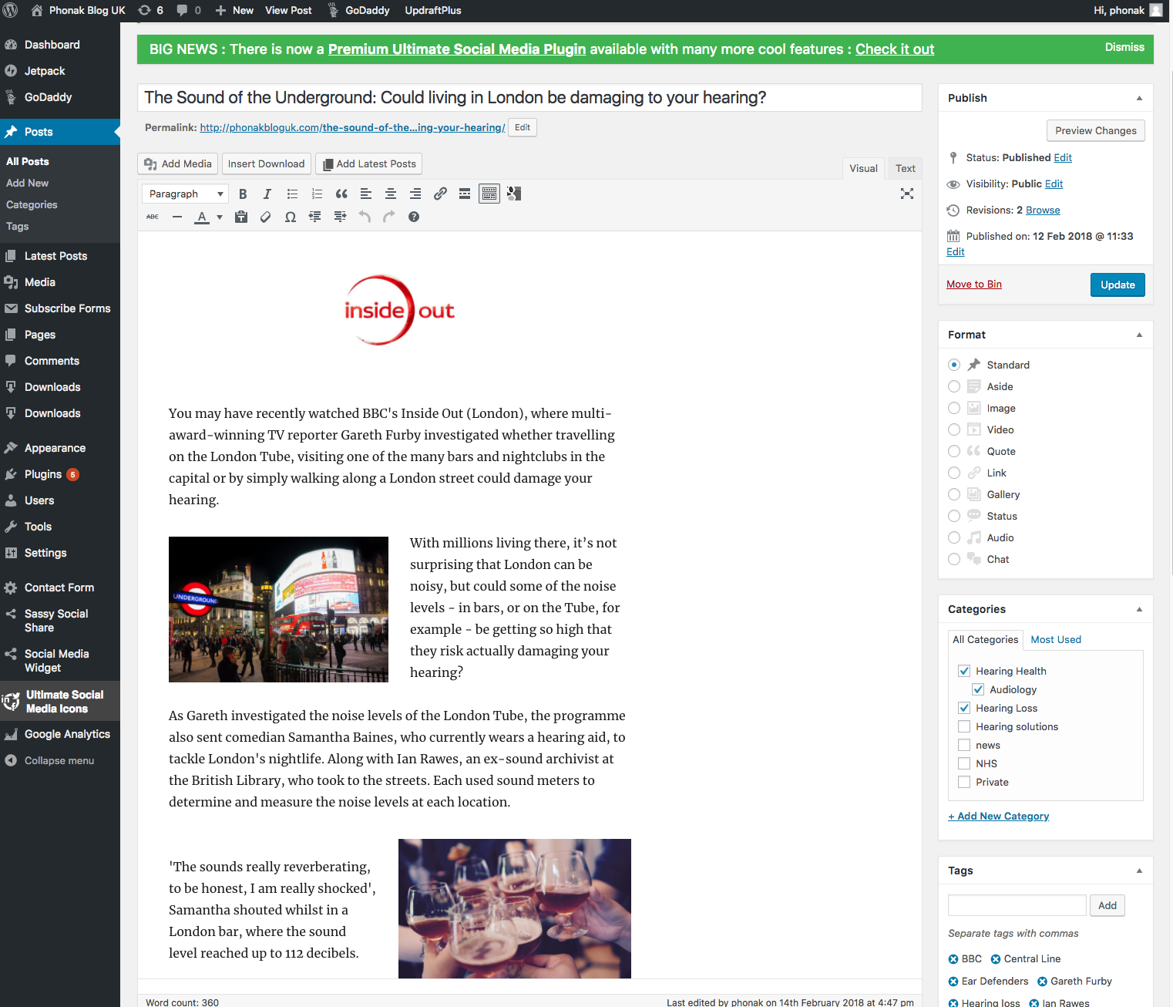

Slide 37
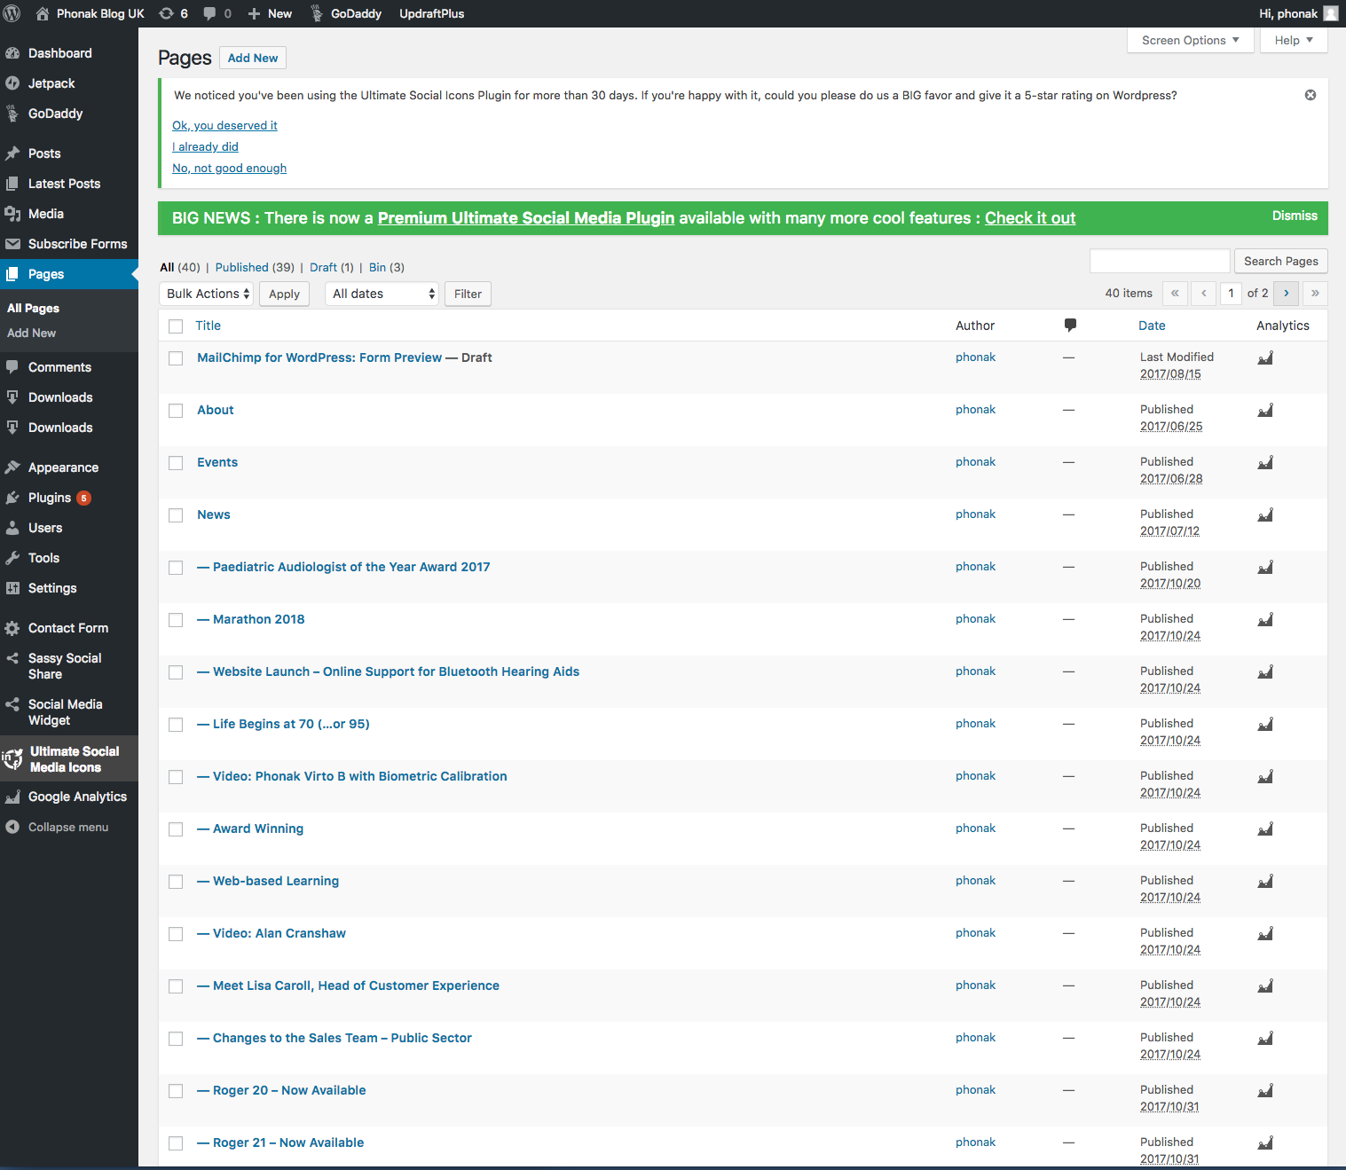

Slide 38
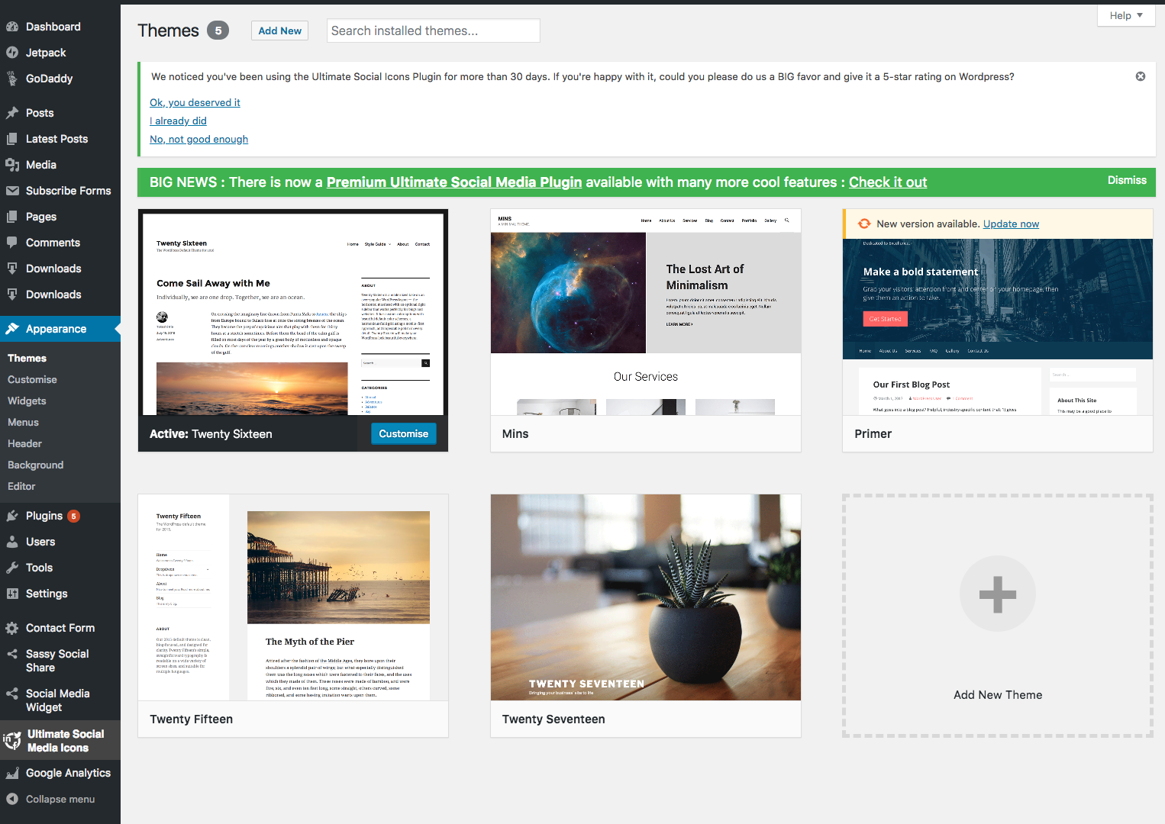

Slide 39
Realistically for Wordpress you are looking at £100 per year on a Wordpress Managed hosting through Go Daddy
A blog site (posts) could easily evolve depending on your needs.

Slide 40
Costs
Realistically for Wordpress you are looking at £100 per year on a Wordpress Managed hosting through Go Daddy
A blog site (posts) could easily evolve depending on your needs.

Slide 43
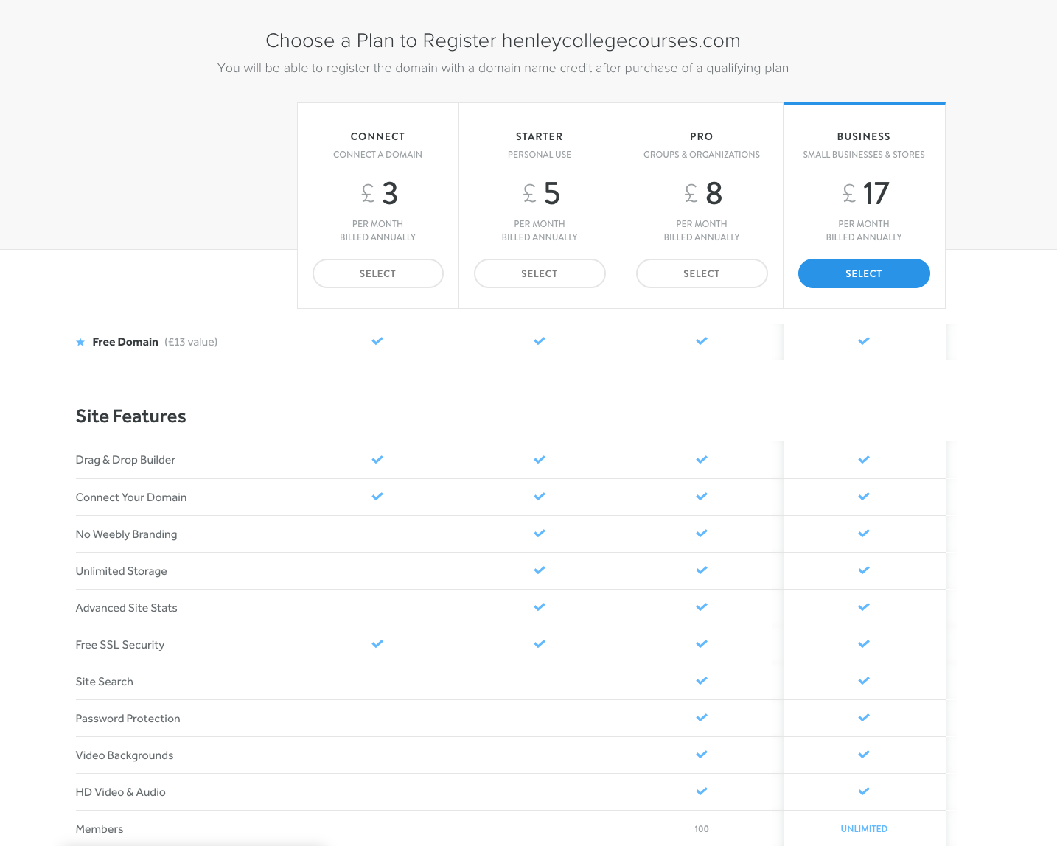

Slide 45
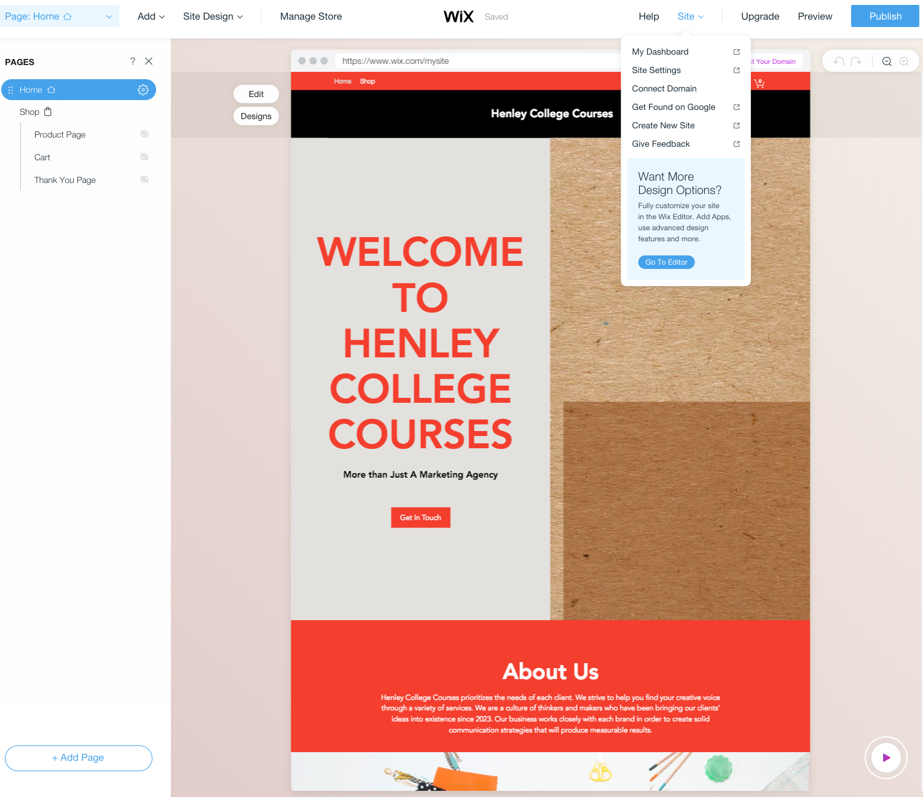

Slide 46
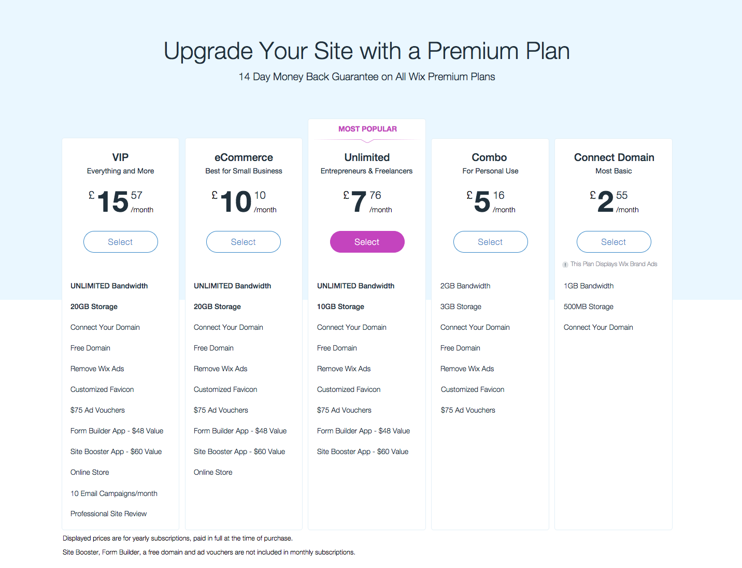

Slide 47
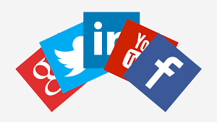
Promote your blog/website – Social Media

Slide 48
Adopt hashtags around your brand or blog topics
#talentedmarketingblog #talentedmarketingtalks
#TMtalksWebsites

Slide 49
Google Keywords Planner
Once you’ve put together a basic list of keywords for your business’ products/services, you can use the Google Keyword Tool to find related terms and phrases to develop a more complete list of possible keywords. This is important, because your customers may use different words and phrases when looking for your products/services.
Start by entering each of the keywords from your website into the tool, being sure that Location under Advanced Options is set to the country that you will be targeting. Also if you want to just select individual keywords make sure the ‘Keyword Ideas’ tab is selected.

Slide 50
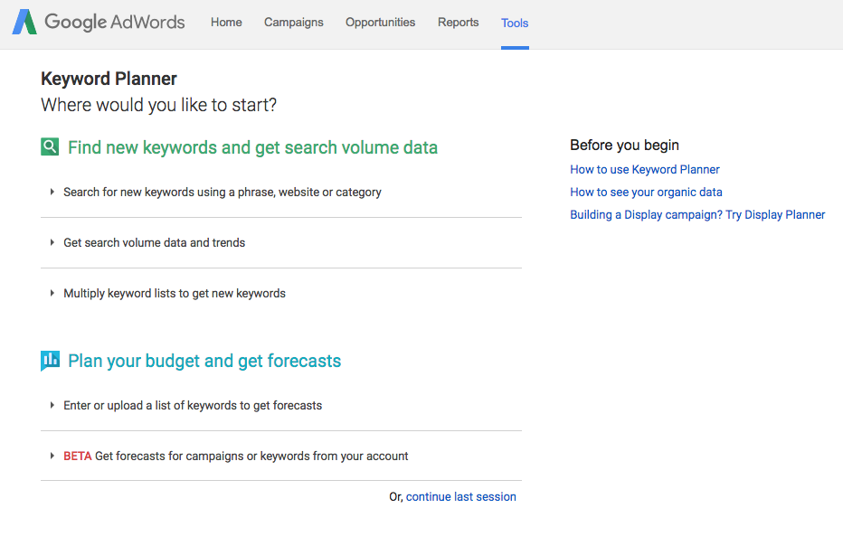

Slide 51
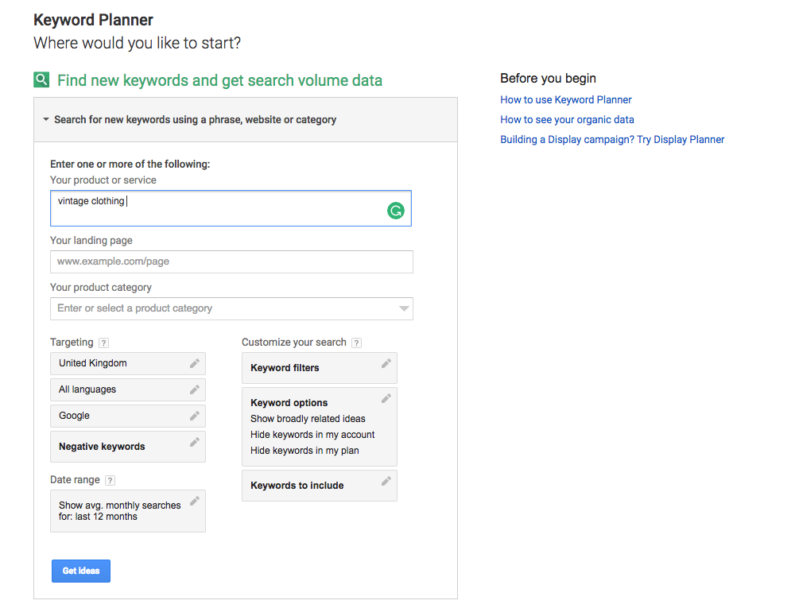

Slide 53
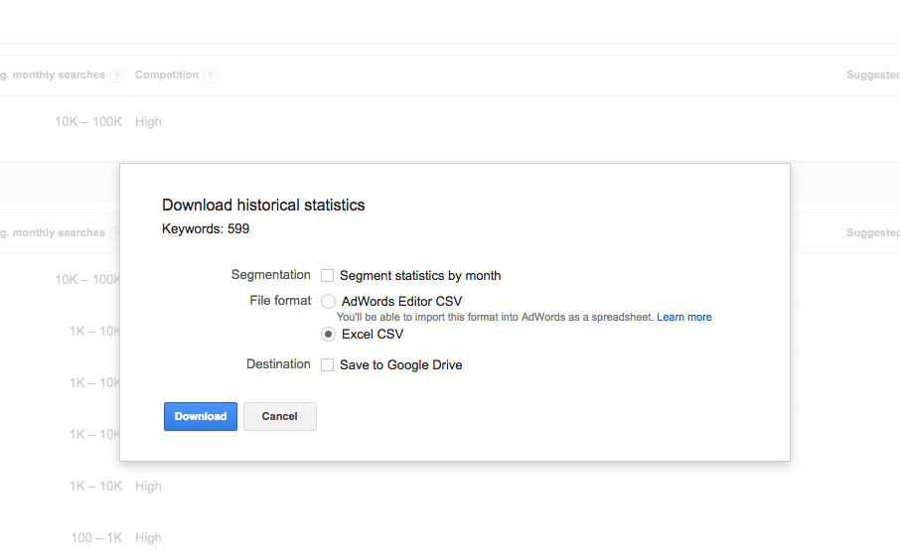

Slide 55
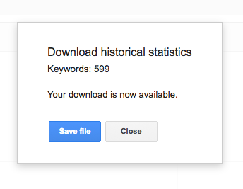

Slide 56
Remember!
One of the biggest mistakes that new advertisers make is throwing any and all semi-relevant keywords into their account, on the basis that more keywords will result in more visitors and sales.
There are a couple of reasons why you don’t want to do this:

Slide 57
Cost
If you’re using Adwords for the first time you probably have a limited advertising budget (if you don’t, you should, at least until you have proven that Adwords is a profitable advertising medium for your business).
In general, the more keywords you have in your account, the more you’ll spend on advertising. It therefore makes sense to start with a smaller number of keywords that are most relevant to your business and most likely to be profitable, and then expand your keyword list

Slide 58
Quality Score
Despite its importance, Quality Score is often one of the most difficult concepts to for new Adwords advertisers to understand. Essentially, the higher your Quality Score (on a scale of 1 to 10), the less you will have to pay per click for your ad to appear in a certain position on the search results page.
It’s therefore possible for an advertiser with an ad in the first position on the page to be paying less than a competitor in position 2, because of higher Quality Score.

Slide 59
Relevance
How relevant is the keyword to the products/services that your business offers? The keyword “woman’s vintage dress” would be a better choice than the more general keyword “woman’s shoes”, which would likely be used by some people searching for products that their business doesn’t offer.

Slide 60
Search volume
While it’s important to focus on targeted keywords that are highly relevant to your business, you also need to strike a balance with search volume – how many people are actually searching for the keyword on Google. Generally, the more targeted a keyword is, the lower its search volume.
Cost
How much will you have to pay each time someone clicks on your ad after searching for this keyword? While not particularly accurate, the Keyword Tool’s Approximate CPC gives you some idea of how expensive a keyword is.
Choosing keyword match types
You’d think that by now we’d be done with keywords. Not quite. For each keyword in an Adwords account, a “match type” must also be chosen, which controls which search queries are eligible to trigger your ad. Correct match type selection can be the difference between a highly profitable Adwords account, and one that wastes money.

Slide 61
Broad match
Broad match is the default option in Adwords, and allows you to reach the largest number of people, but provides the least control over when your ads are shown. For example, if you use the keyword “mens shoes”, your ad will be displayed to people searching for “mens shoes”, “shoes for men online”, and potentially a whole variety of irrelevant search queries such as “brown shoe polish”.
Phrase match
Phrase match provides more control than broad match, but reaches a smaller audience. For a phrase match keyword to display your ad, someone must enter a search into Google that contains your keyword in the same order that you typed it. For example, for the phrase match keyword “mens shoes”, your ad would be displayed to people searching for “mens shoes”, “cheap mens shoes” or “leather mens shoes henley”.

Slide 62
How many campaigns do I need?
There’s a number of reasons why you might want to create multiple campaigns. These include separating advertising based on:
Different products or services
Different budgets
Geographical location
Network (this guide focuses only on the Search Network, however when using the Display Network you should always use separate campaigns)
How many ad groups do I need?
Within each campaign, you’ll need to create at least one ad group, which is a collection of keywords and ads. As a general rule, you should aim for at least three ad groups per campaign.

Slide 63
Writing compelling ads
Ok, we’re ready to start writing some ads. While a complete guide to ad copywriting is beyond the scope of this guide, there are a few things you should keep in mind when writing your ads:
Know your USP
Your USP, or Unique Selling Proposition, explains why a prospective customer should buy your product or service instead of a competitor’s. Including this in your ad will differentiate it from all of the other ads/search results around it.
Think like the searcher
Try to put yourself in the position of someone searching for one of your keywords in Google. What do they want to know about your product/service? What might their objections or concerns be? Answer these questions in your ad if you can.
Include your keyword
Ads that include the keyword, especially in the heading, tend to receive more clicks than ads that don’t. One reason for this is that when a keyword is included in ad text, Google highlights those words in bold, making it more eye-catching.
Include a call to action
A Call To Action tells the searcher what you want them to do once they arrive on your site. For an ecommerce website, this might be “Buy Online Now”. This also helps to filter out people who aren’t going to take the action that you require.

Slide 64
Writing compelling ads
Ok, we’re ready to start writing some ads. While a complete guide to ad copywriting is beyond the scope of this guide, there are a few things you should keep in mind when writing your ads:
Know your USP
Your USP, or Unique Selling Proposition, explains why a prospective customer should buy your product or service instead of a competitor’s. Including this in your ad will differentiate it from all of the other ads/search results around it.
Think like the searcher
Try to put yourself in the position of someone searching for one of your keywords in Google. What do they want to know about your product/service? What might their objections or concerns be? Answer these questions in your ad if you can.
Include your keyword
Ads that include the keyword, especially in the heading, tend to receive more clicks than ads that don’t. One reason for this is that when a keyword is included in ad text, Google highlights those words in bold, making it more eye-catching.
Include a call to action
A Call To Action tells the searcher what you want them to do once they arrive on your site. For an ecommerce website, this might be “Buy Online Now”. This also helps to filter out people who aren’t going to take the action that you require.

Slide 65
Ad rules
If your ad doesn’t meet Google’s rules, it will be disapproved. These include ad formatting rules and Google’s general advertising policies.
Setting up conversion tracking
Access to proper metrics is essential to managing your Adwords account – without them there is no way of knowing if you are achieving your goals, or which advertising (campaigns, ad groups and keywords) is profitable and which are not.
Adwords conversion tracking tool provides important data relating to what a searcher does after clicking on your ad (whether they purchase, submit an enquiry via a contact form, etc.), which allows you to make advertising decisions based on what is actually getting results.
Once you’ve add conversion tracking, you’ll have access to the following metrics:
Cost Per Conversion (how much are you paying for a sale, phone call, etc.)
Conversion Rate (what percentage of visitors are completing a transaction, contacting you, etc.)

Slide 66
Total Conversions (total number of transactions, phone calls, etc.)
Once you have conversion tracking installed, you’ll be able to easily identify where you’re getting results and where you’re not, and then make changes accordingly. Without it, you’re essentially “flying blind”, almost certainly wasting money as a result.
We’ve worked with clients who have wasted thousands of dollars on Adwords (before hiring us) that could have been easily avoided had they been using conversion tracking.
In order to use the Adwords conversion tracking, you’ll need to add a piece of code to your website.
https://support.google.com/adwords/answer/1722054?hl=en

Slide 68
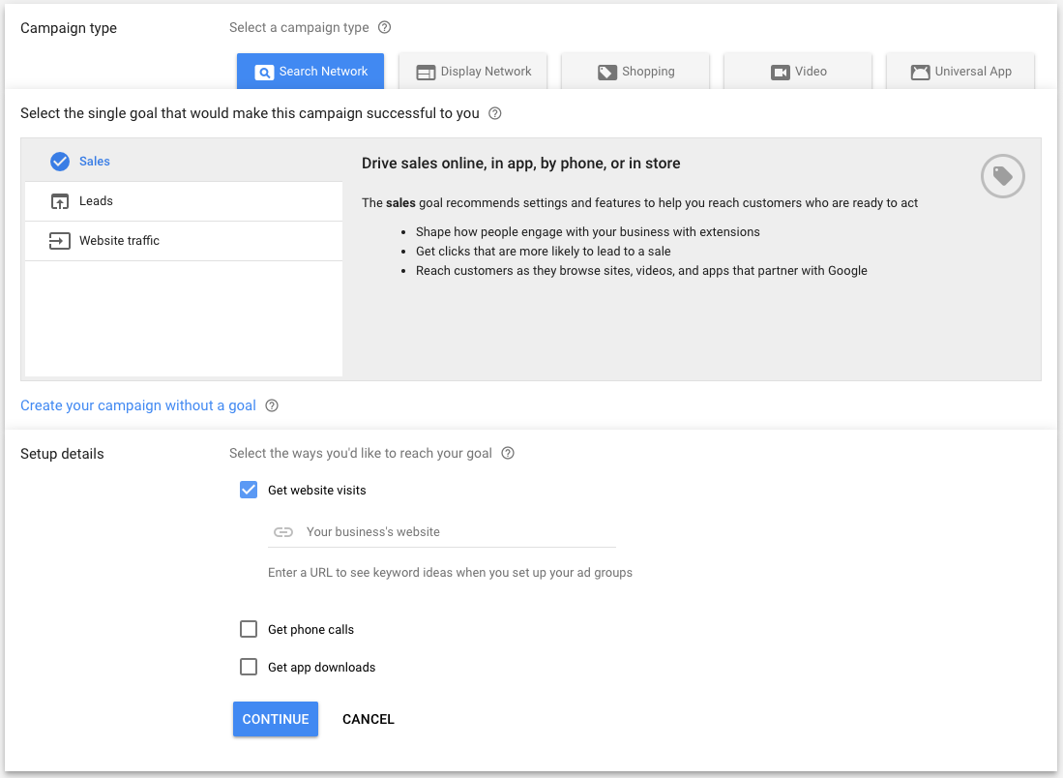

Slide 71
Headline
People are most likely to notice your headline text, so consider including words that people may have entered in their Google search. Your text ad consists of two headlines where you can enter up to 30 characters in each to promote your product or service. The headlines are separated by a dash "-" and may appear differently based on the device someone is using when they view your ad.
Display URL
The display URL, usually in green, shows your website address. This display URL is made up of the domain from your final URL and the text in the optional ”Path” fields. These fields are designed to help people who see your ad get a better sense of where they’ll be taken when they click it. Your path text doesn’t have to match the exact language of your display URL.

Slide 72
Description
Use the description to highlight details about your product or service. It’s a good idea to include a “call to action” – the action you want your customer to take. If you’re an online shoe shop, your description might include “Shop now” or “Buy shoes now”. If you offer a service, you might want to add something like “Get an instant quote online” or “See pricing”.
Length limits
Field Max length
Headline 1 30 characters
Headline 2 30 characters
Description 80 characters
Path (2)* 15 characters each
In expanded text ads, the length limits are the same across all languages. Each character in double-width languages like Korean, Japanese or Chinese counts as two towards the limit instead of one.

Slide 73
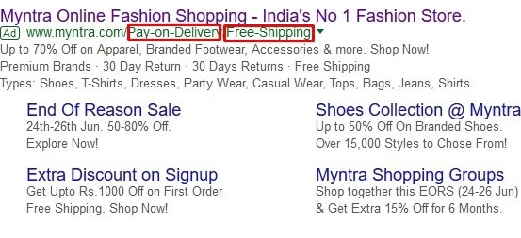
*The “Path” fields are part of the Display URL in expanded text ads, which is typically displayed in green text below the headline and above the description. The fields give potential customers an idea of where they will end up on your site once they have clicked your ad, so the text you put in the fields should describe the product or service described in the ad in more detail. Paths are optional, and they support up to 15 characters each.
AdWords uses the domain from your final URL combined with your path text, if any is entered, to create the Display URL.

Slide 74
Sign in to your AdWords account.
Click the Tools tab and select Ad Preview and Diagnosis.
In the text box, enter the keyword that you want to test. Make sure it’s a keyword that’s included in your campaign, or closely related.
Change any of the other settings (location, language, device) as needed. If you’ve targeted your ad to a certain language, location or device, you’ll need to specify this information to preview your ad.
Click Preview.
Ad Preview and Diagnosis tool

Slide 75
Sign in to your AdWords account.
Click the Tools tab and select Ad Preview and Diagnosis.
In the text box, enter the keyword that you want to test. Make sure it’s a keyword that’s included in your campaign, or closely related.
Change any of the other settings (location, language, device) as needed. If you’ve targeted your ad to a certain language, location or device, you’ll need to specify this information to preview your ad.
Click Preview.
The tool will tell you if your ad is eligible to appear for these search settings. If your ad is eligible to show on the first page of Google search results, you’ll see it highlighted in green. Ads that are eligible and show on the 2nd page or later may not appear in the Ad Preview and Diagnosis tool. Bear in mind that if your ad has extensions, they may not always display in the Ad Preview and Diagnosis tool. View your ad extension performance.

Slide 76
1) AdWords launched in 2000, when searchers were conducting more than 20 million searches per day on google.com. Sixteen years later, the search engine handles more than three billion searches per day. (Search Engine Land)
2) An 18-year-old college dropout named Scott Banister is credited with the brilliant, multi-billion-dollar idea of pay-for-placement search listings, an idea later developed by Bill Gross at IdeaLab. (Search Engine History)
3) AdWords was actually Google’s second advertising program. The first, called Premium Sponsorships, launched just months before. After a few years, AdWords overtook it. (Search Engine Watch)
The Numbers of Today
4) Number of Google Advertisers: Over 4 million (Business Insider)

Slide 77
5) Google’s takes up 33% of global digital ad revenue (Emarketer)
6) About 97% of Google’s total revenue comes from advertising. (Investopedia)
7) Businesses make an average of $2 in revenue for every $1 they spend on AdWords. (Google Economic Impact)
8) The top 3 paid ad spots get 41% of the clicks on the page (Niel Patel)
9) AdWords competitive rate of 87% allows your advertisement to fairly promote your products or services making you a competitor to those in similar industries. (Optimus 01)
Google’s Display and Search Network

Slide 78
10) Number of businesses advertising on the Google Search Network: Over 1.2 million (Wordstream)
11) Number of sites that are part of the Google Ad Display Network: Over 1 million (Wordstream)
12) Google’s display campaigns reach 80% of global internet users (Google Content Network)
13) Consumers exposed to display ads are, on average, 155% more likely to search for brand- and segment-specific terms. (Google Content Network)
14) The average click-through rate of an ad on the Google Display Network is four times as high as the average banner ad in the US and almost ten times as high as a Facebook ad. (Moz)
AdWords Industry Superlatives

Slide 79
15) The most expensive keyword to advertise with Adwords is…’Insurance’ at about $55 per click. (Media Vision Interactive)
16) Dating & Personals industry have the lowest average Cost Per Actions: $6.91 (Search Engine Land)
17) The Legal industry has the highest average Cost Per Actions: $135.17 (Search Engine Land)
18) Industry with the best average conversion rate for AdWords search ads: Insurance and Finance (7.19%) (Search Engine Land)

Slide 80
19) Industry with the best average conversion rate for AdWords display ads: Home Goods (2.19%) (Search Engine Land)
‘Cause We Are Living In A Mobile World
20) 70% of mobile searchers call a business directly from Google Search (AdWords Blog)
21) 33% of all Google search clicks are generated through mobile (Merkle Inc.)
22) There are at least 300,000 mobile apps currently serving Google Mobile Ads (Protocol 80)

Slide 81
Further reading:
https://brianclifton.com/blog/2013/08/20/calculating-your-real-roi-adwords/
https://www.crazyegg.com/blog/successful-adwords-ads/
https://www.upwork.com/hiring/community/successful-adwords-campaign/

