Slide 1
Computing for Business
Microsoft Word

Slide 2
Definition - What does Microsoft Word mean?
Notes:
Microsoft Word is a widely used commercial word processor designed by Microsoft. Microsoft Word is a component of the Microsoft Office suite of productivity software, but can also be purchased as a stand-alone product.
It was initially launched in 1983 and has since been revised numerous times. Microsoft Word is available for both Windows and Macintosh operating systems.
Microsoft Word is often called simply Word or MS Word.

Slide 3
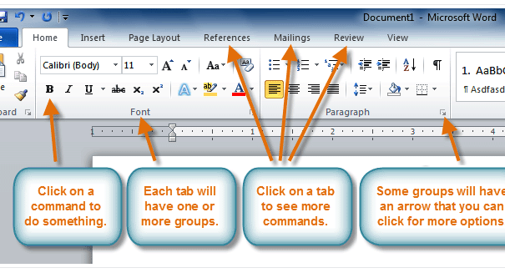
The Ribbon
Notes:
The new tabbed Ribbon system was introduced in Word 2007 to replace traditional menus. The Ribbon contains all of the commands you'll need in order to perform common tasks. It contains multiple tabs, each with several groups of commands, and you can add your own tabs that contain your favorite commands. Some groups have an arrow in the bottom-right corner that you can click to see even more commands.

Slide 4
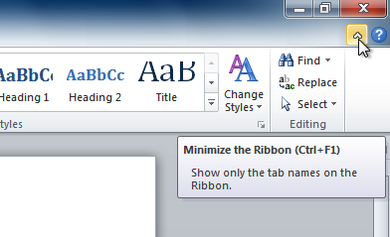
To minimize and maximize the Ribbon:
Notes:
The Ribbon is designed to be easy to use and responsive to your current task; however, you can choose to minimize it if it's taking up too much screen space.
Click the arrow in the upper-right corner of the Ribbon to minimize it.
To maximize the Ribbon, click the arrow again.
When the Ribbon is minimized, you can make it reappear by clicking on a tab. However, the Ribbon will disappear again when you're not using it.

Slide 5
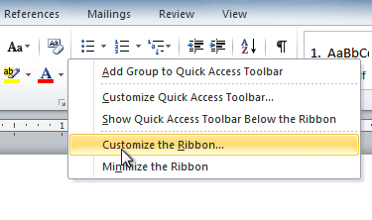
To customize the Ribbon:
Notes:
Right-click the Ribbon and select Customize the Ribbon. A dialog box will appear.
Click New Tab. A new tab will be created with a new group inside it.
Make sure the new group is selected.
Select a command from the list on the left, then click Add. You can also drag commands directly into a group.
When you are done adding commands, click OK.

Slide 6
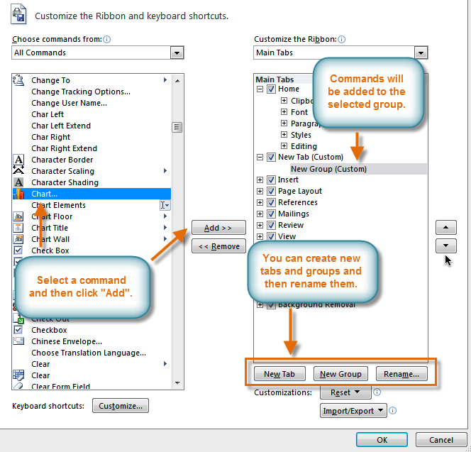
Notes:
If you don't see the command you want, click the Choose commands from: drop-down box, then select All Commands.

Slide 7
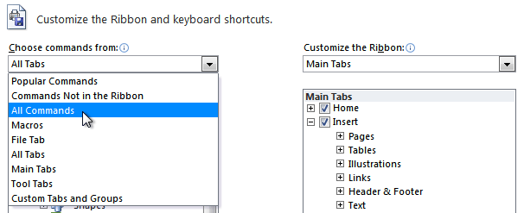

Slide 8
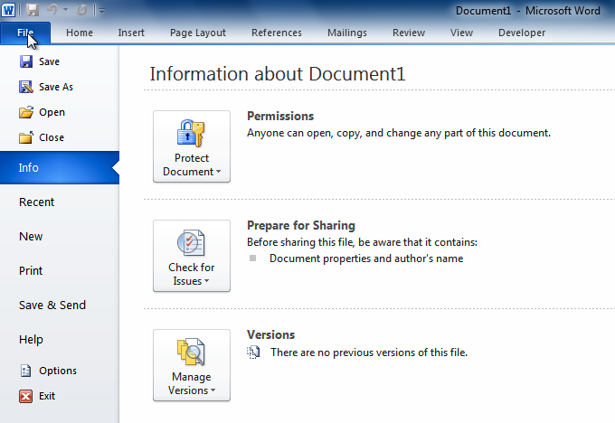
Backstage view
Notes:
Backstage view gives you various options for saving, opening, printing, and sharing your files. It's similar to the Microsoft Office button menu from Word 2007 and the File menu from earlier versions of Word. However, instead of just a menu it's a full-page view, which makes it easier to work with.
Click the File tab.
You can choose an option on the left side of the page.
To get back to your document, click any tab on the Ribbon.

Slide 9
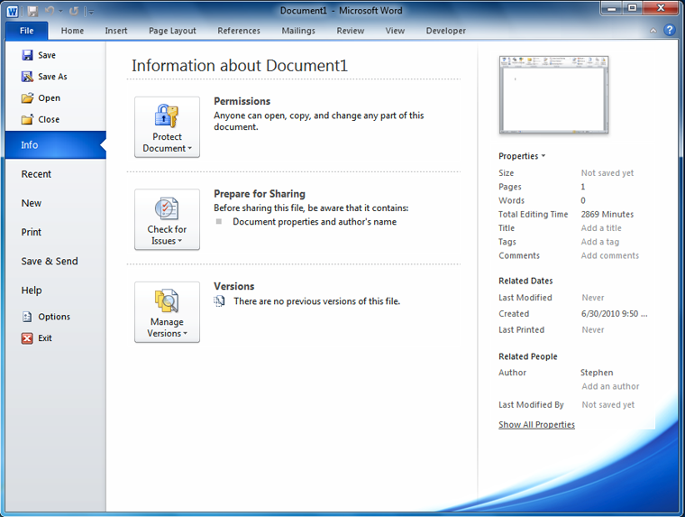
Notes:
Click the buttons in the interactive below to learn about the different things you can do in Backstage view.

Slide 10
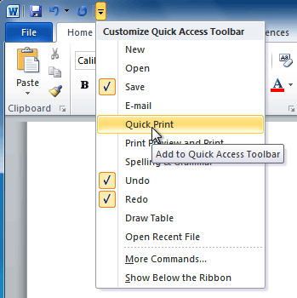
The Quick Access toolbar
Notes:
The Quick Access toolbar, located above the Ribbon, lets you access common commands no matter which tab you're on. By default, it shows the Save, Undo, and Repeat commands. You can add other commands to make it more convenient for you.
To add commands to the Quick Access toolbar:
Click the drop-down arrow to the right of the Quick Access toolbar.
Select the command you want to add from the drop-down menu. It will appear in the Quick Access toolbar.

Slide 11
The Ruler
Notes:
The Ruler is located at the top and to the left of your document. It makes it easier to adjust your document with precision. If you want, you can hide the Ruler to free up more screen space.

Slide 12
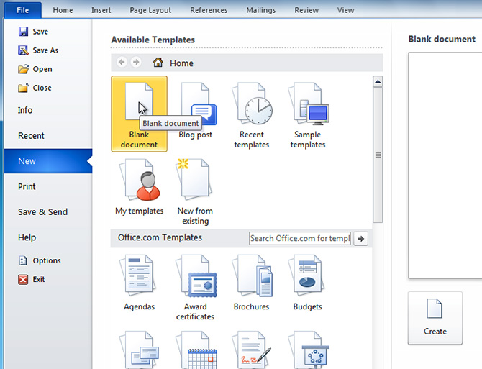
Creating new documents

Slide 13
Compatibility mode
Notes:
Sometimes you may need to work with documents that were created in earlier versions of Microsoft Word, such as Word 2007 or Word 2003. When you open these types of documents, they will appear in Compatibility mode.
Compatibility mode disables certain features, so you'll only be able to access commands found in the program that was used to create the document. For example, if you open a document created in Word 2007, you can only use tabs and commands found in Word 2007.
In the image below, you can see how Compatibility mode can affect which commands are available. Because the document on the left is in Compatibility mode, it only shows commands that were available in Word 2007.

Slide 14
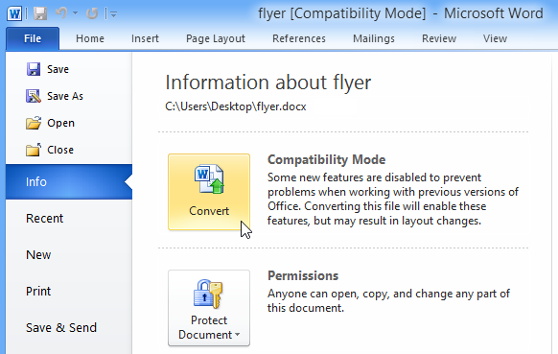
To convert a document:

Slide 16
Image Editing
While not as full-featured as Photoshop, Word's image editing features can often help you transform bad pictures into good ones and good ones into excellent ones.
Notes:
After importing an image or pasting one from the clipboard, you can resize the image, crop it and enhance your picture using a variety of formatting tools. Drag the Brightness slider, for instance, and transform pictures that are too dark into lighter ones you can use. Access Word's picture formatting window by right-clicking an image and clicking "Format Picture." Save the image by selecting "Save Picture" from the right-click menu.

Slide 17
Desktop Publishing
People often use Word's extensive formatting features to create professional newsletters.
Notes:
Word is not as powerful as Microsoft Publisher, but you can manipulate text, insert headings, create borders, add tables and move images to wherever you like using Word. Use your own pictures to design a newsletter or include images from the clip art library. Add colourful flair to publications using WordArt.

Slide 18
Mailing
When you need to send out a newsletter or other material, you can use Word’s label wizard to generate and print your own labels.
Notes:
If you have a mailing list in Excel, or another data source, use Word’s mail merge feature to extract that data and generate customized letters that contain personalized information. You might, for example design a generic form letter that contains basic information and have mail merge generate unique letters for each customer by adding their names and addresses.

Slide 19
Templates
Microsoft has free templates available to Word users. A template is a blueprint used as a starting point to create other documents.
https://templates.office.com
Notes:
If you need a calendar or budget, then this is a handy tool.
After customising a template, you can save it as a new template and allow others in your organization to use it as a starting point for their documents and publications.

